Slide 1
HAI/AR Collaborating Partners
November 3, 2017

Slide 2
Old Business: Chapter 270: Hips and Knees
Chapter 270:
Hip and Knee SSIs
Can IPPS and CAH report KPRO and HPRO by 01/2020 – Troy
Slides:
Does MONAHRQ have quality measures for knee/hip replacement – KH
Risk stratification of SSI data / Is a SIR available in NHSN? – HAI/AR
How do other states report Hip and Knees – HAI/AR
Notes:
Troy – what was the IP response?

Slide 3
Hips and Knees: MONAHRQ
Notes:
KarynLee will discuss MONAHRQ – what it is, prevention measures. Stuart may be able to address this.

Slide 4
Hips and Knees: Risk Stratification (07/2017)
NHSN Risk Stratification for SIRs | Hips | Knees
Age | x | x
Anesthesia | x | x
ASA Score | x | x
BMI | x | x
Diabetes | x | x
Duration of Procedure | x | x
Procedure excluded if duration is | > 5 hrs 49 min | > 5 hr 16 min
Gender |  | x
Hospital Bed Size | x
Medical School Affiliation |  | x
Trauma | x | x
Type of Procedure | Total Revision Partial Revision | Revision
Wound Class | x | x

Slide 5
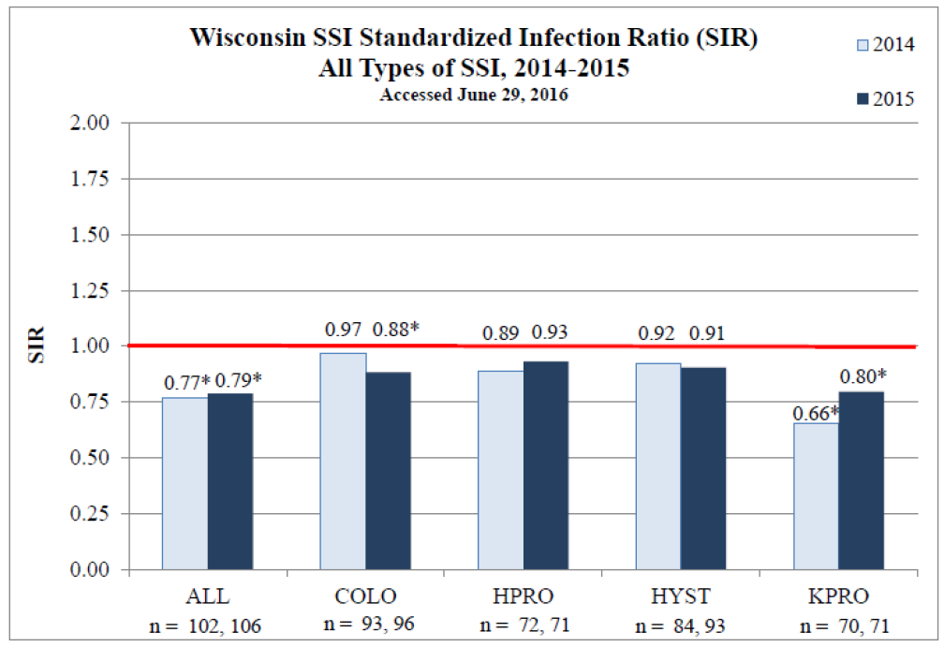
Hips and Knees: How do other States Report?
Wisconsin
Notes:
Example report from Wisconsin – HPRO, KPRO SIRs

Slide 6
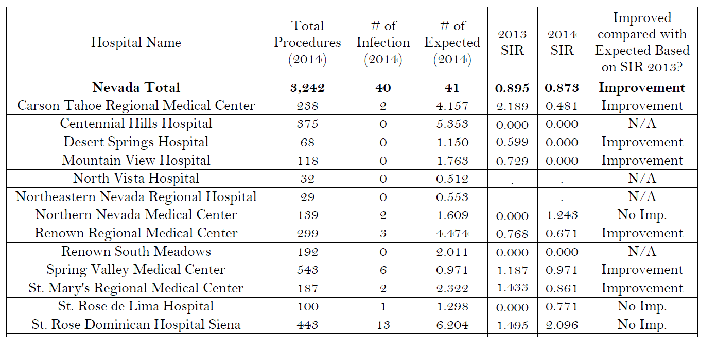
Hips and Knees: How do other States Report?
Nevada

Slide 7
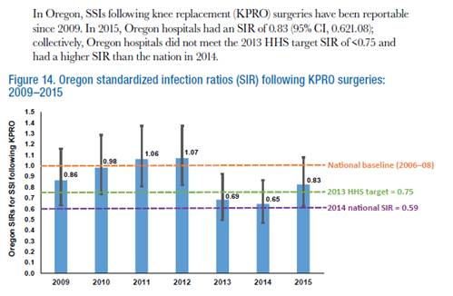
Hips and Knees: How do other States Report?
Oregon
Executive Summary (State-wide)
Data Table (by facility)
Notes:
Overall SIR graph, breakdown in table

Slide 8
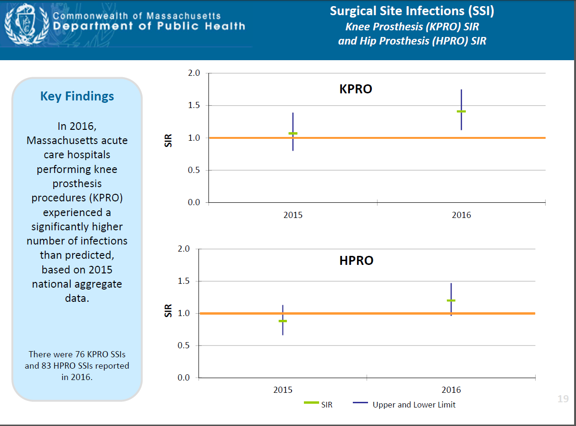
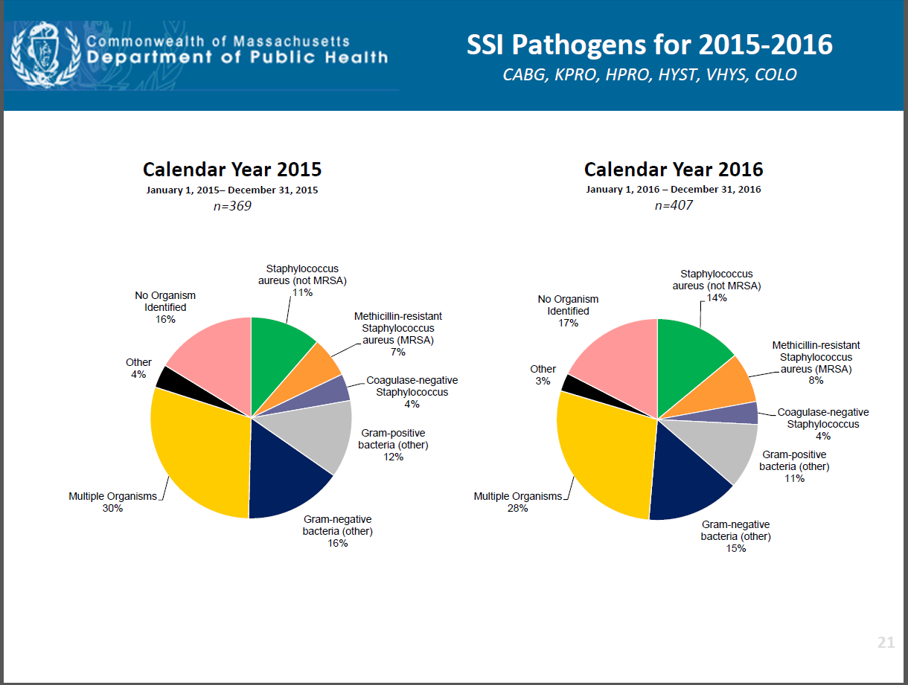
Hips and Knees: How do other States Report?
Massachusetts

Slide 9
Recommendation: Chapter 270 – Hips and Knees
Recommendation Proposed: Chapter 270, Acute Care | In Favor
Include hip (HPRO) and knee (KPRO) replacement SSIs as part of Chapter 270 by 2020. | Room: x / x Phone: x / x Total: x / x
If consensus is not obtained, list major issues/concerns:
1. 2.

Slide 10
Old Business
Inter-facility Communication
Invite Danielle Watford (QIN-QIO) to next meeting to provide her insights on existing communication tools and what other groups are doing
Discuss “important elements” to include in inter-facility communication
CSTE: Whom to contact at the sending facility for more information
Notes:
1 hour

Slide 11
Recommendations
Recommendation Proposed (if any):

Slide 12
Old Business: Infection Preventionist Capacity
APIC Mega Survey
Does you state publish average IP staffing levels by hospital? | 3.9% = Yes
What is the average number of FTEs of IP at the Corporate level? [Responsible for an average of 18.8 hospitals] | 4.0
What is the average number of FTEs of IP at the Hospital level? [Responsible for an average of 9.6 hospitals/facilities] | 2.0
A survey of NHSN facilities, 2014 [975 hospitals responded]
Average number of IPs per 100 beds | 1.2
Notes:
National averages, no breakdowns

Slide 13
Old Business: Infection Preventionist Capacity
Study, 2017: The Relationship Between IP Staffing Levels, Certification, and Publicly Reported HAC Scores (based on 3 months of data 10/1/2013-12/31/2013, 120 hospitals)
IPs per 100 beds | 0.22 – 3.0 range
Average IP FTE | 1 per 149 beds
Did HAC scores improve with increased IP staffing? Every additional IP FTE reduced HAC by 0.005 (p=0.14) Every additional certified IP FTE increased HAC by 0.005 (p=0.08) | Yes and No
Affect at larger facility: Every 100-bed increase in facility size increased HAC score by 0.536 (p=0.02 statistically significant) BUT CABG (p=0.38) and KPRO (p=0.96) SIRs were unaffected | Mixed
Notes:
Does increasing the IP FTE make a difference?

Slide 14
Recommendations: IP Capacity
Recommendation Proposed (if any): | In Favor
 | Room: x / x Phone: x / x Total: x / x
If consensus is not obtained, list major issues/concerns:
1. 2.
Notes:
Interested in pursuing this as a way to decrease infections in Maine? Yes or No? Wait until more data?

Slide 15
Antibiotic/Drug Supply Shortages Overview
Discuss historic context and current trends in drug (including antibiotic/antimicrobial/anti-infective) shortages
Review existing drug shortage resources
Discuss current strategies for drug supply stewardship, including anti-infective agents
Deliberate on potential actions of Collaborating Partners and/or Maine CDC

Slide 16
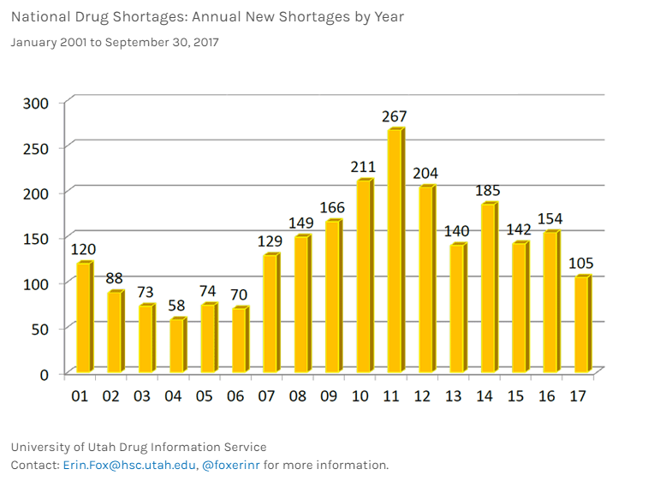
Drug Shortages Historical Perspective

Slide 17
Legal Context for Drug Supply Shortages in the USA
1938 – Federal Food, Drug and Cosmetics Act (FDCA) passed
Adulterated food, drugs, and cosmetics (FD&C) punishable by civil or criminal law
Granted authority to Federal Food and Drug Administration (FDA) to mandate and oversee safety of USA supply of FD&C
High percentage of drug shortages due to sterile injectables
Sterile injectables undergo a highly specialized manufacturing process
Sterile injectable quality or manufacturing issues typically result in drug shortages
Sterility, particulates, precipitates, crystallization, impurities
Production/equipment issues, natural disasters
Notes:
Sterile injectables include: chemotherapy, ANTIMICROBIALS, anesthetics, other acute care meds

Slide 18
Industrial Context for Drug Supply Shortages in the USA
From 2011 Assistant Secretary for Planning and Evaluation Report (FDA):
7 manufacturers make up most of the generic drug market
Contract manufacturers will both contract out manufacturing and serve as contract manufacturers
Existing manufacturing lines at 24/7 capacity
Drug shortages may not be avoidable
FDA works closely with various manufacturers to mitigate existing and anticipated drug shortages to meet public health need
Drug allocation “smart distribution” (temporary importation)
Regulatory discretion (minor, low risk issues only +additional safety controls)
Dissemination of information
Expedite review of company proposals
Notes:
lack of financial incentive to expand production of other drugs
Because manufacturing lines are already at capacity, complicates plan of action to mitigate existing shortages w/o creating new ones
Public health need: prioritize medically nec supplies; risk/benefit of drug, maintain availability while minimizing risks
Last bullet: new manufacturing sites, increased exp date, new raw material sources, change in specifications…

Slide 19
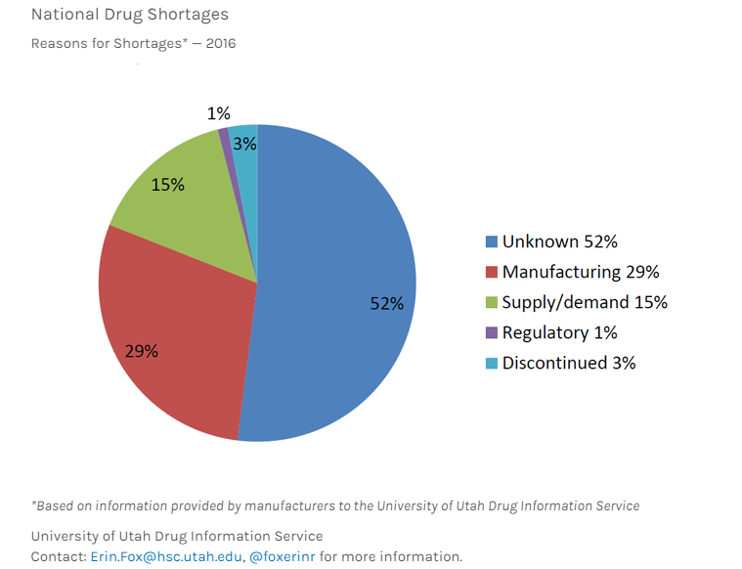
Reasons for National Drug Shortages, 2016

Slide 20
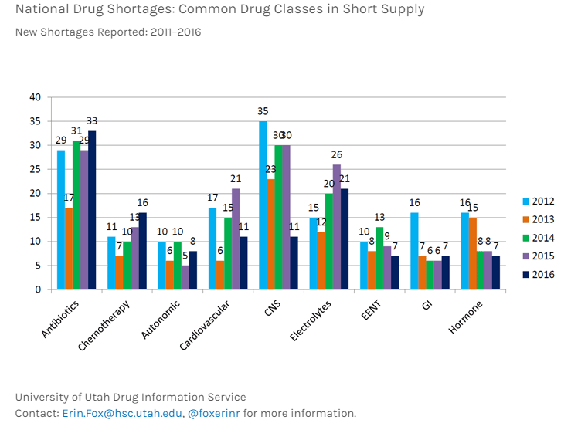
Drug Shortages Historical Perspective

Slide 21
Implications of Anti-infective Drug Shortages
Delays in treatment of infection
Use of alternative (second- or third-line) agents may promote use of:
Unnecessarily broad spectrum antimicrobials
Antimicrobials with less clinical data available
Delayed treatment or use of alternative agents can lead to:
Medication errors
Increased costs
Lapses in safe injection practices
Suboptimal treatment
Increased drug toxicities
Poorer patient outcomes
Notes:
https://www.ncbi.nlm.nih.gov/pmc/articles/PMC4419815/

Slide 22
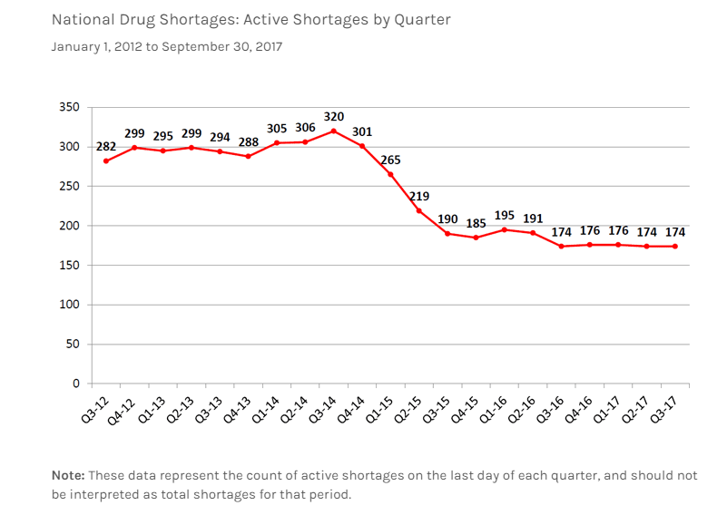
Drug Shortages Historical Perspective
Notes:
What Do These Numbers Mean?
The rate of new shortages has decreased
Long-term active and ongoing shortages are resolving
Shortages of basics like antibiotics, electrolytes, and cardiovascular agents still impact large numbers of clinicians and patients

Slide 23
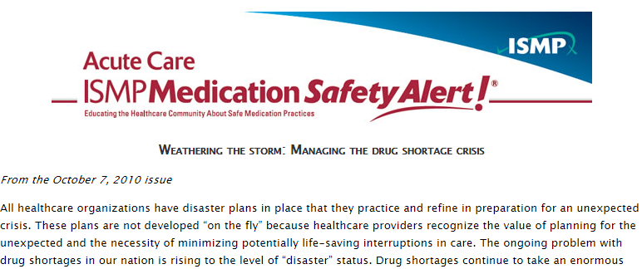
Institute for Safe Medication Practices 2010 Bulletin
Identify drug shortages and learn more
Assess inventory of drugs on hand
Research drugs in short supply (Drug Use Evaluation)
Identify potential therapeutic alternatives early
Prioritize patients and place limitations on use
Conduct a failure analysis and take action
http://www.ismp.org/newsletters/acutecare/articles/20101007.asp

Slide 24
ISMP Medication Shortage Management
Do not hoard shortage or alternative drugs
Establish ongoing communication with staff
Engage ethics committee and risk management
Establish a drug shortage network with other local healthcare providers
Determine and organizational position on alternative suppliers
Proactively monitor adverse events associated with drug shortages
http://www.ismp.org/newsletters/acutecare/articles/20101007.asp

Slide 25
Drug/Antibiotic Shortage Resources
FDA Drug Shortages website
https://www.fda.gov/Drugs/DrugSafety/DrugShortages/default.htm
https://www.accessdata.fda.gov/scripts/drugshortages/default.cfm
Animal drug shortages: https://www.fda.gov/AnimalVeterinary/SafetyHealth/ProductSafetyInformation/ucm248095.htm
Drug Shortages 2 app available on Android devices
American Society of Health-System Pharmacists (ASHP) Drug Shortages Resource Center
https://www.ashp.org/Drug-Shortages
https://www.ashp.org/Drug-Shortages/Current-Shortages/Drug-Shortages-List?page=CurrentShortages
Drug shortages maintained in collaboration with University of Utah Drug Information Service (UUDIS) http://pharmacyservices.utah.edu/drug-information/drug-shortages.php
CDC Current Vaccine Shortages and Delays
https://www.cdc.gov/vaccines/hcp/clinical-resources/shortages.html

Slide 26
Drug Shortage Resources: FDA vs. ASHP/UUDIS
FDA | ASHP/UUDIS
Receives information provided by manufacturers regarding their ability to supply the market Receives market sales data on the specific products Lists drugs on its website once it has confirmed that overall market demand is not being met by the manufacturers of the product Does not consider a product to be in shortage if one or more manufacturers are able to fully supply market demand for the product | Provides information about which manufacturers have the drug available and which ones do not, since supply chain disruptions may occur when all previous manufacturers are not yet back on the market with all formulations and all dosage sizes Lists drugs in shortage even if the full market demand is met by the current manufacturers
Additional background: http://www.healthaffairs.org/do/10.1377/hblog20150408.046227/full/
Notes:
Essentially: FDA evaluates drug shortages via manufacturer info – supply/demand
ASHP considers clinician/RPh reports of shortages affecting drug delivery process (i.e. only smaller vials of vanco in supply, may not be considered drug shortage per FDA)

Slide 27
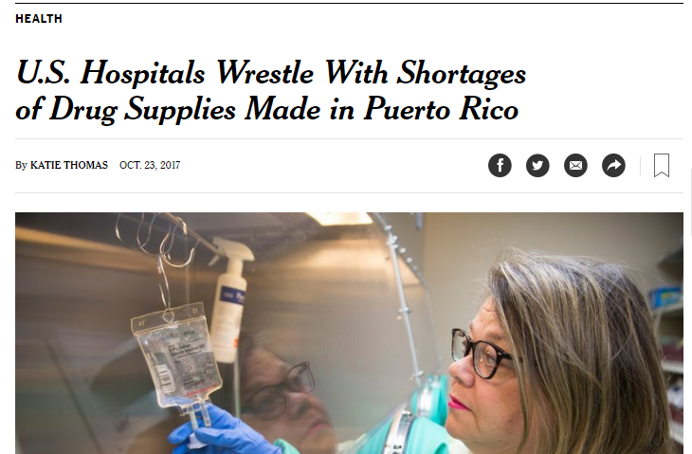
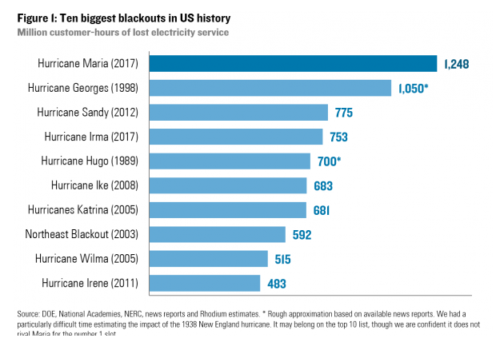
October 2017: Hurricane Maria + Puerto Rico = Critical Shortages
Hurricane Maria hit Puerto Rico on September 20, 2017
75% of Puerto Rico remains without power today
Puerto Rican infrastructure (including healthcare) under strain
Major delays in manufacturing of parenteral fluids, drugs, devices
Notes:
http://www.newsweek.com/san-juan-mayor-suggests-trump-administration-too-afraid-attend-fema-hearing-697187
https://www.fda.gov/NewsEvents/Newsroom/PressAnnouncements/ucm581436.htm
https://www.fda.gov/NewsEvents/Newsroom/PressAnnouncements/ucm580290.htm
https://www.theatlantic.com/politics/archive/2017/10/puerto-ricos-health-care-crisis-is-just-beginning/544210/ While most hospitals have recovered from the storm’s early blows—which knocked most of them out of commission and left a few others dependant on generators—they have had to make do with shortages of power, water, and supplies; personnel crunches; and intensifying health-care needs from accidents and emergent diseases.
At both hospitals, Pichardo has faced new challenges. At first, doctors and nurses dealt with a total collapse of power, which Pichardo said was the “scariest change” immediately after the storm. Hospitals couldn’t communicate with other hospitals; specialists often couldn’t be reached if they were needed; and patients were transferred to trauma centers or other facilities without any knowledge of whether those institutions could handle more patients.
While lines of communication have at least partially been restored, Pichardo said that problems still abound. “At this point, everything has become challenging,” she told me by email. “Many primary-care physicians are unable to provide services at their practice locations, so more and more people are using the emergency rooms for everyday medical problems. This places a larger burden on the emergency rooms and increases wait time among patients. Children have fallen behind on their immunization schedules, because either their pediatricians are not currently practicing or they have lost their refrigerated vaccines due to power outage.”
MD shortage already – work going to mainland USA

Slide 28
ASHP/UUDIS Small-Vol. Parenteral Solutions Shortages Suggestions for Management and Conservation
What can clinicians do to conserve?
Consider changing to 500 mL or 1L bags to start IV lines or flush with single use syringes
Switch drug administration to IV push whenever possible
One Needle, One Syringe, Only One Time
Consider system-wide communication to all clinicians who administer medications
Switch therapy to a clinically appropriate oral product whenever possible (IV->PO)
Particularly for anti-infectives with good bioavailability properties (i.e. linezolid, levofloxacin have 100% PO bioavailability)
P&T should review current IV->PO policies – consider need to expand policy language to include additional drug categories (i.e. electrolytes)

Slide 29
ASHP/UUDIS SVP Solutions Shortages Suggestions for Management and Conservation, cont.
If PO not feasible/indicated, some meds may be administered via intramuscular (IM) and/or subcutaneous (SQ) injection
Caution maximum volume for a single injection – doses may need to be divided into more than one syringe
Review drug formulations and available products that may allow changes to an alternative route of administration
Explore opportunities to use large-volume parenterals for continuous infusion
Piperacillin-tazobactam, cefepime, oxacillin, magnesium
Consider changes in EHR to allow flexibility to use either dextrose or saline for drugs compatible with both solutions
Use alerts or forced functions when a drug is compatible with only one diluent
Review stock of SVPs and vials to determine stock on hand that is compatible with mix-on-demand supplies (Vial2Bag®, Add-Advantage®, or Mini-Bag™ Plus)

Slide 30
ASHP/UUDIS SVP Solutions Shortages Suggestions for Management and Conservation, cont.
Inventory Control Strategies
Evaluate supplies on a health-system-wide basis and redeploy SVPs to areas of greatest need.
Realign stock so the pharmacy has control over all SVPs. (Remember procedural areas, ORs, etc.)
Stock SVPs only in areas where final medication solutions for administration must be prepared.
Ensure that purchasing agents have active backorders in place, and are obtaining allocations as available. Ensure that additional accounts are set up for direct purchases.

Slide 31
ASHP/UUDIS SVP Solutions Shortages Suggestions for Management and Conservation, cont.
For additional guidance on:
Pharmacy operational strategies
Infusion pumps / Informatics strategies
Caveats / Safety information
See FDA-endorsed ASHP/UUDIS SVP Solutions Shortages Suggestions for Management and Conservation document (October 18, 2017)
https://www.fda.gov/downloads/Drugs/DrugSafety/DrugShortages/UCM582461.pdf

Slide 32
Pharmacy/Antimicrobial Stewardship Strategies for Management of Drug Shortages
Facility-wide messaging and updates
Physician and nursing notification and education important
Prospective tracking of potential shortages
Provide recommendations for safe and appropriate therapeutic alternatives
Track inventory of critical antimicrobials, including anticipation of alternative agents and creation of contingency plans
Development of protocols for use of alternative agents to prevent errors
Guideline development, antibiotic time outs, IV to PO switch
Ensuring ethical distribution to patients with the greatest need
Antimicrobial restriction/approval
Quadri F, Mazer-Amirshahi M, Fox ER, et al. Antibacterial drug shortages from 2001 to 2013: implications for clinical practice. Clin Infect Dis. 2015;60(12):1737-42.
Notes:
https://academic.oup.com/cid/article-lookup/doi/10.1093/cid/civ201

Slide 33
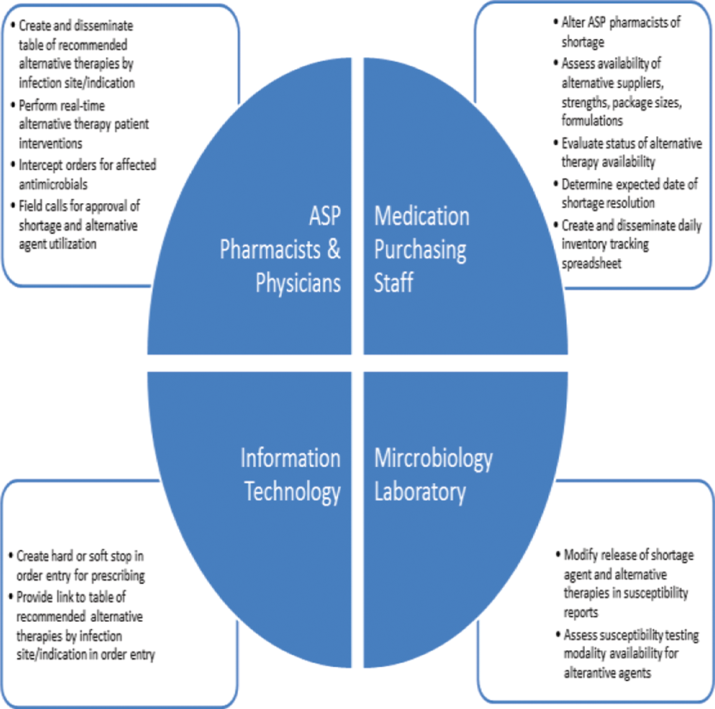
Wexner Medical Center (OSU) Critical Shortage Team and Respective Responsibilities
Reed E, McKinley LN, Srinivas P, et al. Antimicrobial Stewardship Program's Approach to Managing Critical Antimicrobial Shortages, Open Forum Infectious Diseases, Volume 3, Issue suppl_1, 1 December 2016, 1325,

Slide 34
HAI/AR Collaborating Partners Role in Antibiotic Shortages
Maine CDC HAI/AR can:
Maintain references for drug (antibiotic) shortages
Provide consultation on drug supply shortages, particularly in regards to infection control and antimicrobial stewardship/use
Facilitate communication of critical drug supply shortages with direct public health implications to Maine facilities and/or patients
No existing infrastructure to work with facility-specific antimicrobial stewardship/P&T teams
Your ideas on how HAI/AR Collaborating Partners can support Maine facilities on drug (antibiotic) supply issues?

Slide 35
Antibiotic and Other Drug Supply Recommendations
Recommendation Proposed (if any): | In Favor
 | Room: x / x Phone: x / x Total: x / x
If consensus is not obtained, list major issues/concerns:
1. 2.

Slide 36
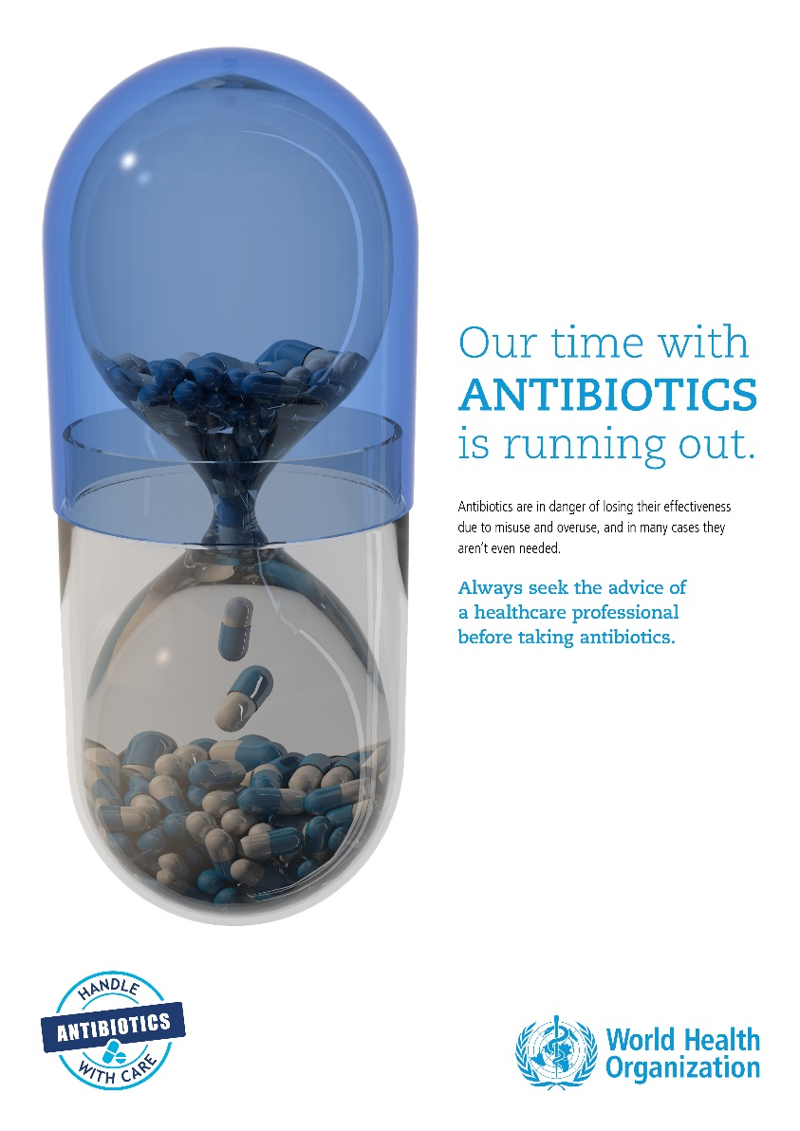
New Business – Patient Education
Antimicrobial Stewardship
World Antibiotic Awareness Week
Letters to the editor in newspapers
Newsletters
Social Media: Facebook ads and posts, Twitter posts and chats, Thunderclap
Table at ME CDC Infectious Disease Conference
Movie Theatre ads - December
HAI
Focusing on this topic in 2018

Slide 37
State Antibiogram Overview
Define an antibiogram and understand its utility in antimicrobial stewardship and clinical practice
Review CLSI standards for publishing an antibiogram
Discuss how to proceed with implementation of a State of Maine Antibiogram

Slide 38
Antibiogram
Antimicrobial resistance “report card”
Usually published on an annual basis
Guides selection of empiric antimicrobial therapy
Tool to trend resistance rates or emergence of resistance over time at a facility
Vital component of Core Elements of Antimicrobial Stewardship
Action, Tracking, Reporting, Education
Laboratory maintains data
Responsible for providing antibiograms to facilities

Slide 39
Antibiogram Example

Slide 40
CLSI M39 Cumulative Antibiogram Development Guidelines
Compile, analyze and present data at least annually
Include diagnostic (not surveillance) results only
Include final, verified results only
Include only the first isolate per patient per reporting period
Include only species with testing data for >30 isolates per reporting period
Include only antimicrobial agents routinely tested
Report only %S (not %I – except for viridians strep and penicillin)
Streptococcus pneumoniae – meningitis and non-meningitis breakpoints for penicillin (+PO), ceftriaxone, cefotaxime
Staphylococcus aureus - %S for all isolates and MRSA subset

Slide 41
State of Maine Antibiograms in Existence and Resistance Trends
Special thank you to Cathy Dragoni for sending NorDx antibiograms
N=5
MMC; Pen Bay +Waldo County; Stephen’s Memorial Hospital; Lincoln Healthcare; Southern Maine Healthcare
Located EMMC antibiogram online (N=1)
In general, high susceptibilities of organisms versus broad spectrum antibiotics
Any Maine facilities utilizing unit- (ICU) or disease-state specific antibiograms?
Should this be pursued with the State Antibiogram project?
Notes:
Last bullet: besides usual suspects of intrinsic R (“SPICE”), p.aeruginosa, enterococcus faecium

Slide 42
State Antibiogram Discussion Points
Data source
2016 – plan to use antibiograms published by NorDx / ALI /other labs
Consider facility- or lab-specific differential antibiogram characteristics
Should we mandate antibiogram reporting? (MI, NH, LA county)
http://publichealth.lacounty.gov/acd/docs/AntibiogramInstructions.pdf
State versus Regional Antibiogram
By County/public health district?
By Facility type? (Acute vs. LTC vs. outpatient vs. ED)
Disease state-specific antibiogram?
UTI, SSTI, RTI
Need for unit specific antibiogram?
By patient specific factors?
Age, CAUTI vs. UTI

Slide 43
State Antibiogram Recommendations
Recommendation Proposed (if any): | In Favor
 | Room: x / x Phone: x / x Total: x / x
If consensus is not obtained, list major issues/concerns:
1. 2.

Slide 44
Plan for 2018
Prep: Winter 2017-2018
HAI/AR Needs Assessment
Meeting Schedule (tentative)
February
May
August (end of)
Months to avoid: Jun, Jul, Sept, Oct, Nov, Dec
Topics
2018 Topics from HAI State Plan 2015-2018
HAI: Public Reporting of Outbreak data
HAI: External Validation update
AR: Explore impact of antibiotic shortages on AMS recommendations
AR: Explore patient education regarding culturing, results, regimen
HAI State Plan 2019-2023
Notes:
Meeting schedule – does February, May, and August work for everyone? No specific date planned yet? Fridays still work best?
Review needs assessment in Feb and make recommendations, review draft plan in May, accept final plan in August

Slide 45
Meeting Wrap-up:
Meeting Evaluation
Plus
Delta

Slide 46
Questions?
Rita Owsiak MS, MT(ASCP), CIC
Healthcare Associated Infections Coordinator
Rita.Owsiak@maine.gov
Phone: 207-287-6028
Jennifer Liao, PharmD
Antibiotic Resistance Coordinator
Jennifer.Liao@maine.gov
Phone: 207-287-6516
Brittany Roy, MPH
Healthcare Associated Infections Specialist
Brittany.Roy@maine.gov
Phone: 207-287-2682

