Slide 1
HAI/AR Collaborating Partners Meeting
August 24, 2018

Slide 2
Agenda
1200-1210 Introductions and Opening Comments
1210-1220 Review of Minutes
1220-1245 Membership Updates
1245-1540 New Business:
Next State HAI/AR Plan – PREVENTION
Antibiotic Resistance & Stewardship Subcommittee
1540-1550 Public Comments
1550-1555 Meeting Evaluation
1555-1600 Next Meeting/Parking Lot & Adjournment

Slide 3
Member Updates
Infectious Disease Physicians
Dr. Valenti resigned, Dr. Pinsky is new representative
Maine Society Health System Pharm. Representative
Anthony Casapao resigned, reached out to group for new representative
Clinical Laboratory: ALI Representative
Anthony Casapao resigned, will connect with new ALI Lab Director this fall
State Public Health Laboratory Representative
Rick Danforth resigned, Nick Matluk is new representative
Consumers for Affordable Healthcare Representative
Emily Brostek resigned, reaching out to group for new representative

Slide 4
State HAI/AR Plan 2020-2024
2018:
State planning
2019:
Align plan with ELC Grant Award on new 5-year cycle (new federal goals)
State planning continues
State approval
2020: The work begins continues!

Slide 5
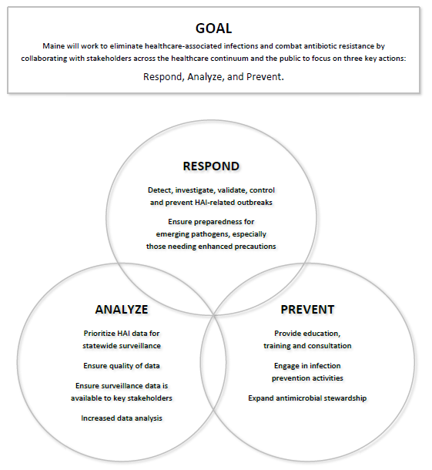
State HAI/AR Plan…

Slide 6
PREVENT – Healthcare Associated Infections

Slide 7
Overview
Seeking a state strategy to reduce and prevent HAIs, across all healthcare facility types and HAI categories
Align with federal initiatives
Uses data to drive improvement
Targets facilities with higher rates
Using Acute Care as an example…
Background
Proposal
Discussion

Slide 8
Cost and Mortality on Selected Metrics
HAI Quality Indicator | Impact 2017 HAI Events | Estimated Average Healthcare Cost per HAI | Estimated Maine Healthcare Cost | Estimated Mortality (literature) | Where are we? 2017 SIR (2015 baseline) | Target SIR 2020
CDI (HO) | 249 | $15,000 2008 | $3.7 M | 45 18% | 0.693 = | ≤ 0.70
CLABSI | 50 | $20,00 2009 | $1.0 M | 10 19% | 0.900 ↑↓ | ≤ 0.50
MRSA (BSI, HO) | 23 | $34,500 2010 | $0.8 M | 5 20% | 0.712 ↑ | ≤ 0.50
SSI (COLO, HYST) | 49 | $21,000 2014 | $1.1 M | 2 3% | 0.968 ↓ | ≤ 0.70
CAUTI | 78 | $7,670 2016 | $0.6M | 2 2% | 1.320 ↑↓ | ≤ 0.75

Slide 9
Clostridium difficile Infection CDI

Slide 10
Central Line Associated Blood Stream Infection CLABSI

Slide 11
Methicillin Resistant Staphylococcus aureus Blood Stream Infection MRSA-BSI

Slide 12
Catheter Associated Urinary Tract Infection CAUTI

Slide 13
TAP Strategy
The Targeted Assessment for Prevention (TAP) Strategy is a framework for quality improvement developed by the Centers for Disease Control and Prevention (CDC) to use data for action to prevent healthcare-associated infections (HAIs).
The TAP Strategy consists of three components:
1) Running TAP Reports in the National Healthcare Safety Network (NHSN) to target healthcare facilities and specific units with an excess burden of HAIs.
2) Administering TAP Facility Assessment Tools to identify gaps in infection prevention in the targeted locations.
3) Accessing infection prevention resources within the TAP Implementation Guides to address those gaps.
https://www.cdc.gov/hai/prevent/tap.html

Slide 14
Summary of Acute Care Data
Healthcare Facility | Data | Benchmark | Current Standing | # facilities higher than Benchmark
Acute Care | CDI | National Average = SIR ≤ 1.00 ₂₀₁₅ DHHS 2020 = SIR ≤ 0.70 | 0.69 ₂₀₁₇ On Target | 5 8
 | CLABSI | National Average = SIR ≤ 1.00 ₂₀₁₅ DHHS 2020 = SIR ≤ 0.50 | 0.90 ₂₀₁₇ Not on Target | 3 5
 | MRSA-BSI | National Average = SIR ≤ 1.00 ₂₀₁₅ DHHS 2020 = SIR ≤ 0.50 | 0.71 ₂₀₁₇ Not on Target | 0 4
 | CAUTI | National Average = SIR ≤ 1.00 ₂₀₁₅ DHHS 2020 = SIR ≤ 0.75 | 1.32 ₂₀₁₇ Not on Target | 4 5
Total Hospitals = 32

Slide 15
Proposal “Working Draft”
Target facilities with high rates, based on last 4 quarters of data (AUGUST)
Maine CDC to determine benchmark that captures top 10% of facilities with high rates
Letter to facilities from Maine CDC or Collaborating Partners to CEO/Quality Director/IP
Facilities to participate in an Assessment activity with Maine CDC (SEPTEMBER)
How do we want to encourage participation?
Summary report to facility (OCTOBER)
Provides ‘evidence’ for what may be suspected, may uncover new territory to consider
Tool to secure leadership support
Facility selects and rolls out Prevention (mitigation) strategy(s) (NOV-MAY) 6 mo.
Can chose a strategy provided or propose alternate strategy
Discuss strategy and roll out with Maine CDC
Enter HAIs in NHSN within 30-days
Monthly progress check-ins (NOVEMBER – JUNE)
Facility connects with Maine CDC on progress
Maine CDC monitors progress of facility in NHSN during Prevention phase
Maine CDC provides facility with final report to CEO/Quality Director/IP (JULY)

Slide 16
Operationalizing
Start with:
CLABSI,
CAUTI
MRSA-BSI
Notes:
CLABSI, CAUTI are a federal CDC priority
CLABSI, CAUTI, MRSA-BSI are HAIs that are ‘Not on Target” to meet DHHS 2020 goals

Slide 17
Then move on to other opportunities…
Healthcare Facility | Data | Benchmark | Current Standing | # facilities higher than Benchmark
Extended Care | UTI | National Average = 3.2% | 4.62% | 60 out of 100 (8 w/rate ≥ 10%)
Acute Care | SSI | National Average = SIR ≤ 1.00 ₂₀₁₅ DHHS 2020 = SIR ≤ 0.70 | 0.968 On Target | Colo=6, Hyst=1 Colo=2, Hyst=0
Ambulatory Care | Dialysis BSI | National Average = SIR ≤ 1.00 ₂₀₁₄ | 0.73 | 8 out of 17

Slide 18
Surgical Site Infection Colon Surgeries (COLO) + Abdominal Hysterectomies (HYST)

Slide 19
PREVENT – Antibiotic Resistance

Slide 20
Overview
Create a similar state-wide process for Antibiotic Resistance
Roadblocks
Lack of Data (hoping to resolve this within next year)
Will need to create a State Prevention strategy
States utilizing different approaches
Example: Antimicrobial Stewardship (AS) HONOR ROLL
Priority
Work on detail to finalize this process
Ambulatory Care (2,500 clinics in Maine, 80% of antibiotics prescriptions)

Slide 21
State of Maine Antimicrobial Resistance & Stewardship Subcommittee

Slide 22
State of Maine Antimicrobial Resistance & Stewardship Subcommittee
Proposed Purpose/Goals:
AR: refine AR data for clinical and public health applications
AS: develop prevention/quality activities that link together individual ASPs
Both: enhance Maine’s capacity for AR prevention
Projects:
State and Regional Antibiogram
All Payers Claim Database or Part D for outpatient antibiotic use
AS Honor Roll
AR = Antibiotic Resistance
AS = Antibiotic/Antimicrobial Stewardship

Slide 23
AR-AS Subcommittee – Points for Discussion
What is the ideal make up? (think numbers and discipline)
Inpatient, outpatient, extended care, quality, public health, laboratory
Doctors/Providers, Pharmacists, Nurses, Infection Preventionists, other healthcare staff, microbiology, academia, quality
How should recruitment be rolled out?
Separate AR and AS subcommittee?
Meeting Frequency – biannual? Quarterly?
Anyone you would like to nominate?

Slide 24
Questions?
Rita Owsiak MS, MT(ASCP), CIC
Healthcare Associated Infections Coordinator
Rita.Owsiak@maine.gov
Phone: 207-287-6028
Jennifer Liao, PharmD
Antibiotic Resistance Coordinator
Jennifer.Liao@maine.gov
Phone: 207-287-6516

