Slide 1
HAI/AR Collaborating Partners
February 22, 2019

Slide 2
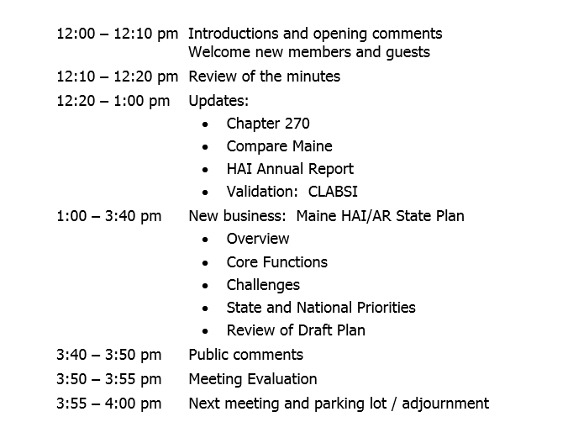
Agenda
Maine Department of Health and Human Services – Maine Center for Disease Control and Prevention – Healthcare Epidemiology Program

Slide 3
Membership
New Members
Dr. Sarah Buss
Northern Lights Laboratory (formerly ALI)
Maine Department of Health and Human Services – Maine Center for Disease Control and Prevention – Healthcare Epidemiology Program

Slide 4
Updates
Chapter 270
Compare Maine
HAI Annual Report
Validation: CLABSI
Maine Department of Health and Human Services – Maine Center for Disease Control and Prevention – Healthcare Epidemiology Program

Slide 5
State HAI/AR Plan
Maine Department of Health and Human Services – Maine Center for Disease Control and Prevention – Healthcare Epidemiology Program

Slide 6
Overview
HAI/AR Programs were started by federal grant dollars.
Federal funding is a large percentage of Maine’s HAI/AR budget and therefore federal grant requirements are a large percentage of HAI/AR activities.
It is a grant requirement to have a State HAI/AR Plan
Maine Department of Health and Human Services – Maine Center for Disease Control and Prevention – Healthcare Epidemiology Program

Slide 7
Federal Grant
Grant has a 5-year cycle, with a renewal application each year.
The first year of a 5-year cycle is a “competitive” year for funds.
Years 2-5 are usually funded similar to year 1, if progress made.
Next 5-year cycle begins 08/01/2019.
2019: Annual Plan + 5-year overview
2020: Annual Plan
2021: Annual Plan
2022: Annual Plan
2023: Annual Plan
Maine Department of Health and Human Services – Maine Center for Disease Control and Prevention – Healthcare Epidemiology Program

Slide 8
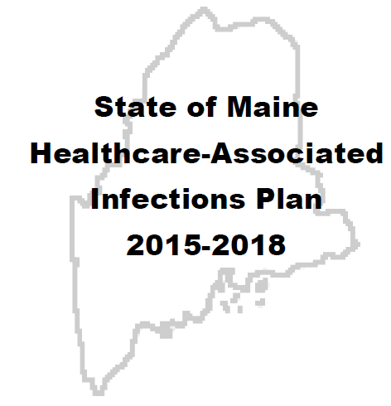
Maine’s HAI/AR State Plan 2015-2018
Modeled after federal grant requirements in 2014.
First 5-year grant cycle for HAI/AR
Development of HAI/AR program core functions
Explored several topics
5 years later…
Maine Department of Health and Human Services – Maine Center for Disease Control and Prevention – Healthcare Epidemiology Program

Slide 9
Goal
Maine will work to eliminate healthcare-associated infections and combat antibiotic resistance by collaborating with stakeholders across the healthcare continuum and the public to focus on three key actions:
RESPOND
PREVENT
ANALYZE
Maine Department of Health and Human Services – Maine Center for Disease Control and Prevention – Healthcare Epidemiology Program

Slide 10
RESPOND
The Healthcare Epidemiology Program (formerly the HAI/AR Program) Core Functions:
Offers phone consults to any healthcare facility for HAI/AR inquiries, clusters/outbreaks.
Offers non-regulatory Infection Control site visits, upon invitation by healthcare facility.
Acts as a liaison between healthcare facilities and the State Public Health Laboratory to obtain bacteria strain identification for clusters/outbreaks.
Works to slow the spread of novel/targeted MDROs, such as Candida auris, carbapenemase-producing organisms, colistin-resistant organisms, pan drug-resistant organisms, Staphylococcus aureus non-susceptible to vancomycin.
Containment activities involve the screening of high-risk potentially exposed patients to identify possible transmission of novel/targeted MDROs within a healthcare facility.
If possible transmission is identified, the program assesses for and works with healthcare facility to mitigate gaps in infection control.
The program works with the State Public Health Laboratory to ensure testing platforms are available for novel/targeted MDROs.
Works with Public Health Emergency Preparedness (PHEP) to maintain highly infectious disease readiness for at least one Assessment Hospital in Maine. Currently, Maine has three Assessment Hospitals.
Maine Department of Health and Human Services – Maine Center for Disease Control and Prevention – Healthcare Epidemiology Program

Slide 11
ANALYZE
The Healthcare Epidemiology Program Core Functions:
Ensures data quality of HAI/AR data reported to NHSN per state or federal mandates.
Works with MQF and HAI/AR Collaborating Partners to determine state HAI/AR mandates.
Conducts surveillance for novel/targeted MDROs via the Notifiable Conditions Rule.
Conducts outbreak/pattern/trend surveillance using data available through state and federal databases.
Adopts national HAI/AR outbreak definitions, as they become available.
Compiles an annual HAI summary report for each Acute Care and Critical Access Hospital. Facility-specific reports are distributed to the CEO and IP.
Compiles a HAI high rate report for facilities with HAI rates above the targeted threshold. Facility specific reports are distributed to the CEO and IP.
Maine Department of Health and Human Services – Maine Center for Disease Control and Prevention – Healthcare Epidemiology Program

Slide 12
PREVENT
The Healthcare Epidemiology Program Core Functions:
Supports MQF’s Infection Prevention Forum, an on-line infection prevention and control training repository for Nursing Home staff.
Promotes the use of the federal CDC’s Targeted Assessment for Prevention (TAP) Strategy in hospitals with high rates, especially if a hospital is not already engaged in another HAI prevention strategy.
Supports MQF’s duty to publicly report HAI/AR data.
Distributes AR educational materials.
Works with Hospitals and Nursing Homes to increase the number of facilities that have implemented all seven core elements of an Antimicrobial Stewardship Program.
Promotes public education of AR during Antibiotic Awareness Week (November).
Publicly reports state surveillance data via the Infectious Disease Annual Report.
Maine Department of Health and Human Services – Maine Center for Disease Control and Prevention – Healthcare Epidemiology Program

Slide 13
Maine’s HAI/AR State Plan 2020-2024
Challenge: Balancing State needs with federal grant requirements
Challenge: Incorporate all healthcare setting types into the State Plan
Outcomes: Focus on gaps/needs and work for resolution over next 5 years
Uncertainty: Federal funding sources (AR > HAI), as funding sources determine priorities
Assumption: Grant requirements for next 5 years will build on the structure from the last 5-years
Maine Department of Health and Human Services – Maine Center for Disease Control and Prevention – Healthcare Epidemiology Program

Slide 14
State and National HAI/AR Priorities
Maine
Public education about HAI and AR
Obtaining HAI data from Nursing Homes
Maintaining emerging pathogen readiness
Reducing HAIs with greatest impact: CLABSI
Promoting transparency of HAI data
Expanding the use of the Infection Prevention Forum
Federal CDC (based on requirements in current grant)
Ensure NHSN data quality
Partner with key stakeholders
Promoting transparency for HAI/AR outbreaks
Slow the spread of novel/targeted MDROs (containment)
Promote the use of TAP Strategy for HAI high rate reduction
Conduct healthcare facility infection control assessments for outbreaks and high rates
Ensure Hospitals and Nursing Home achieve all seven core elements of AMS Program
Maine Department of Health and Human Services – Maine Center for Disease Control and Prevention – Healthcare Epidemiology Program

Slide 15
More National HAI/AR Priorities
CORHA [The Council for Outbreak Response: Healthcare Associated Infections and Antimicrobial Resistant Pathogens]
Standardized HAI/AR outbreak definitions
CSTE [Council of State and Territorial Epidemiologists]
Novel/targeted MDROs as Nationally Notifiable Conditions
ARSTF [Antimicrobial Resistance Surveillance Task Force]
State Antibiogram, by state mandate
Active surveillance for colonization with novel/targeted MDROs
Encourage use of most up to date antibiotic sensitivity breakpoints
Antibiotic utilization and resistance (AUR) data reported, by state mandate
Develop antibiotic sensitivity data suppression guidance for novel/targeted MDROs
Rapid identification of infected/colonized patients with novel/targeted MDROs via a State Registry (such as the Illinois XDRO Registry: https://www.xdro.org/index.html)
Maine Department of Health and Human Services – Maine Center for Disease Control and Prevention – Healthcare Epidemiology Program

Slide 16
Maine Department of Health and Human Services – Maine Center for Disease Control and Prevention – Healthcare Epidemiology Program

Slide 17
“Strengthening our Core”
Outbreaks
Special
Pathogens
OUTPATIENT
Antimicrobial
Stewardship
HOSPITAL
AMS / CLABSI
Education
NURSING HOME
Surveillance
Data for Action
RESPOND
PREVENT
ANALYZE
Maine Department of Health and Human Services – Maine Center for Disease Control and Prevention – Healthcare Epidemiology Program

Slide 18
Today’s “Ask”
As we look at each of these topics…
Is this the “right” project?
If we can fix a gap/need in the next 5 years, what would that project be?
Are these the “right” outcome measures?
There will be one or more outcome measures listed for each project (where to we want to be in 5 years?).
Potential Initiatives (how we will get to the outcome measures) are presented to help answer the first two question. Discussion is welcomed, however, we have time to build our initiatives.
Maine Department of Health and Human Services – Maine Center for Disease Control and Prevention – Healthcare Epidemiology Program

Slide 19
Nursing Home Surveillance
MHCA, Maine CDC, MQF
Outcome Measures:
Nursing Home HAI/AR surveillance manual
Most Nursing Home IPs trained on HAI/AR surveillance
Offered Administrator-level discussion at each MHCA Fall Conference
Potential Initiatives:
Develop a surveillance manual ( adding 1-3 HAIs per year)
Offer education to IP via web and in-person training sessions
Expand state mandates for HAI reporting in Nursing Homes
Urine, Skin/Soft Tissue, Respiratory, GI, Blood, MDRO (skin, GI)
Build web-based training for mandated HAI reporting
Connect with Administrators on mandated reporting, Infection Prevention hours, need for surveillance, interrupting the data, etc.
Maine Department of Health and Human Services – Maine Center for Disease Control and Prevention – Healthcare Epidemiology Program

Slide 20
Outpatient Antimicrobial Stewardship
Maine CDC, MQF, QIN-QIO
Outcome Measures:
Reduce high usage rates of outpatient antibiotics by 30-50% at selected practices
Potential Initiatives:
Target clinics with high antibiotic usage rates for reduction/prevention activities (data need listed under Data for Action)
Activities to be determined
Maine Department of Health and Human Services – Maine Center for Disease Control and Prevention – Healthcare Epidemiology Program

Slide 21
Hospital HAI – AMS / CLABSI
MHA, Maine CDC
Pattern: 1/3 of Maine CLABSIs are related to Candida sp.
Use of antimicrobials inhibit normal flora and allows for Candida overgrowth
Candida CLABSIs are associated with high mortality, high cost
Maine data: 12 Candida-associated CLABSI/year, 5 hospitals
Actions taken to reduce Candida CLABSIs will likely reduce other CLABSIs
Outcome Measures:
Eliminate CLABSIs attributed to Candida sp.
AMS outcome?
Potential Initiatives:
Engage hospitals through a AMS / CLABSI collaborative
Develop prevention strategy, include role of antibiotics on Candida spp.
Maine Department of Health and Human Services – Maine Center for Disease Control and Prevention – Healthcare Epidemiology Program

Slide 22
Special Pathogen Readiness
Maine CDC
Outcome Measures:
Convert State Ebola Plan to a State Special Pathogens Plan
Potential Initiatives:
Determine role of Assessment Hospitals for non-Ebola special pathogens
Work to move all required Laboratory testing for Assessment Hospitals from state public health lab to Hospital
Frontline hospital readiness ?
Maintain readiness: tie to licensure? State mandate?
Maine Department of Health and Human Services – Maine Center for Disease Control and Prevention – Healthcare Epidemiology Program

Slide 23
Education
Maine CDC, MQF
Outcome Measures:
Conduct one round of public education for both HAI and AR each month/quarter/year
What do we want for professional education ?
Potential Initiatives:
Increase education to public on HAI and AR using social media, public service announcements (methodology must be low to no cost)
Increase Maine Infection Prevention Forum courses
IC Risk Assessment ?
Infection Control Plans ?
Hand Hygiene: Train-the-Trainer ?
Water Management Plans ?
Other ?
Maine Department of Health and Human Services – Maine Center for Disease Control and Prevention – Healthcare Epidemiology Program

Slide 24
Data for Action
HAI/AR Collaborating Partners
Outcome Measures:
State Antibiogram by 2024
State HAI/AR mandates for next 5 years ?
Nursing Home: UTI, Other?
Hospitals: ?
State access to outpatient AMS data for performance improvement
State access to inpatient AMS data for performance improvement
Potential Initiatives:
Expand public reporting of HAI/AR data
Develop annual State Antibiogram, by state mandate for standardization
Develop process for reporting of HAI to prior HCF, when identified by next HCF
Data mining capability for All Payer Claims Data (APCD) for Outpatient antimicrobial stewardship (AMS) activities
Develop process for Inpatient AMS data (e.g. National Health and Safety Network (NHSN) – antibiotic utilization and resistance (AUR) module)
Maine Department of Health and Human Services – Maine Center for Disease Control and Prevention – Healthcare Epidemiology Program

Slide 25
Outbreaks
HAI/AR Collaborating Partners
Outcome Measures:
??
Potential Initiatives:
Develop/adopt outbreak definitions
Ensure reporting of clusters/outbreaks to public health
Consider reporting deadlines on mandated HAI data (e.g. 30 days)
Determine authority for public health to conduct Infection Control Assessment
Outline process for 2-way communication between Maine CDC and Division of Licensing and Certification (DLC)
Increase healthcare facility transparency to the public/customers
Develop communication process for patient/resident transfer
Develop communication process for notifying local hospitals when cluster/outbreak in nearby facility
Develop process for public communication of investigation findings
Tool: transfer mapping database
Maine Department of Health and Human Services – Maine Center for Disease Control and Prevention – Healthcare Epidemiology Program

Slide 26
Future Meetings
Preliminary Agenda
April 26th
State HAI/AR Plan
Changes related to new grant requirements
Work on Initiatives for each project
Membership
Review membership in relation to State HAI/AR Plan
Program authority (to enter a facility)
August 23rd
October 25th
Maine Department of Health and Human Services – Maine Center for Disease Control and Prevention – Healthcare Epidemiology Program

Slide 27
Questions?
Rita Owsiak MS, MT(ASCP), CIC
HAI Coordinator
Maine CDC
Rita.Owsiak@maine.gov
Phone: 207-287-6028
Maine Department of Health and Human Services – Maine Center for Disease Control and Prevention – Healthcare Epidemiology Program

