Slide 1

Healthcare Associated Infection Reporting Requirements
June 29, 2023
1:00 – 2:00pm EST

Slide 2
Participant Reminders
Please mute your audio.
Please submit questions via the webinar chat feature.
We will address as many questions as possible at the end of today’s webinar. For those questions we are unable to get to, answers will be available in the FAQ posted in the portal.
A recording of the webinar will be distributed after the webinar and made available on the MHDO website.

Slide 3
Agenda
  Welcome & Review of Agenda
  Overview of MHDO
  Review HAI Reporting Requirements
              Rule 90-590 Chapter 270, Uniform Reporting System for Health Care Quality Data Sets
              Protocol for HAI Data Collection and Reporting
              Process for HAI Data Submission
  Review Maine’s Infection Prevention Forum Website
  Questions
  Closing Remarks

Slide 4
Maine Health Data Organization (MHDO)
The MHDO is responsible for the collection, secure storage, management and authorized release of healthcare data and information per the requirements defined in Title 22, Chapter 1683, and thirteen agency rules, including Rule Chapter 270, Uniform Reporting System for Health Care Quality Data Sets
Data Sets submitted to MHDO include: private and public claims data, hospital inpatient and outpatient encounter data, hospital quality data, pharmacy data, hospital financial and provider organizational data and nursing facility quality data.
MHDO maintains over 1 billion healthcare records and that number grows every month with new data submissions.

Slide 5
MHDO Rule Chapter 270, Uniform Reporting System for Health Care Quality Data Sets
Rule Chapter 270 defines the health care quality data sets and the provisions for filing the data sets to the Maine Health Data Organization.
The provisions include:
Identification of the organizations required to report;
Establishment of requirements for the content, form, medium, and time for filing health care quality metrics data;
Establishment of standards for the data reported; and
Compliance provisions.

Slide 6
MHDO Rule Chapter 270, Uniform Reporting System for Health Care Quality Data Sets
2. Healthcare Associated Infection Quality Data Set Filing Description
A. For all patients identified as eligible cases in the specific denominator and numerator categories (minus exclusions) specified by NHSN, each hospital or their agent shall report data to the US CDC’s NHSN for the following healthcare associated infection (HAI) quality metrics in accordance with NHSN specifications:
HAI-6 Catheter-associated urinary tract infection rates for adult and pediatric patients in intensive care units, medical units, surgical units, medical/surgical units, mixed acuity units and rehabilitation units beginning January 1, 2020 July 1, 2023. (Measure steward – NHSN).
B. For all patients identified as eligible cases in the specific denominator and numerator categories specified by NHSN, each hospital, or their agent, shall submit to the US CDC’s National Healthcare Safety Network (NHSN), data for the following healthcare associated infection (HAI) quality metrics in accordance with NHSN specifications, beginning with all qualifying surgical procedures performed on or after January 1, 2020 July 1, 2023:
HAI-7 Surgical Site Infection rate for patients undergoing inpatient knee prosthesis (arthroplasty of knee) surgical procedures (KPRO) (Measure steward – NHSN); and
HAI-8 Surgical Site Infection rate for patients undergoing inpatient hip prosthesis (arthroplasty of hip) surgical procedures (HPRO) (Measure steward – NHSN).

Slide 7
Reporting Timeline
Data Collection Begins on July 1, 2023
Data collected during each calendar quarter shall be submitted no later than the 15th day of the 5th month following the end of each quarter.
The first quarterly data submission will be for data collected for the months of July-September 2023. The submission deadline is February 15th, 2024. Although facilities are required to make quarterly data submissions, separated out by month, facilities are urged to submit their data to NHSN each month.

Slide 8
Filing Periods and Deadlines
The Filing Periods and Deadlines are as Follows:
Collection Quarter | Months | Submission Date (no later than)
1st Quarter | January, February, March | August 15th
2nd Quarter | April, May, June | November 15th
3rd Quarter | July, August, September | February 15th
4th Quarter | October, November, December | May 15th

Slide 9
MHDO Rule
Chapter 270
2. H. Each health care facility shall also authorize the MHDO to have access to the NHSN for facility-specific reports of data submitted for any healthcare associated infection measure under a state or federal mandate, for the purpose of public reporting.
2.G. In lieu of reporting data directly to MHDO, each health care facility shall authorize Maine CDC to have access to the NHSN for facility-specific reports of data submitted for any healthcare associated infection measure under a state or federal mandate, and shall authorize the Maine CDC to use this data for data validation, public health surveillance and performance improvement purposes.
Facilities will have to confer new rights to the MHDOqualitydata group in NHSN (ID# 38498) so that MHDO can see these new measures.
Slides 10-14 provide instructions on how to confer new rights.
Uniform Reporting System for Health Care Quality Data Sets

Slide 10
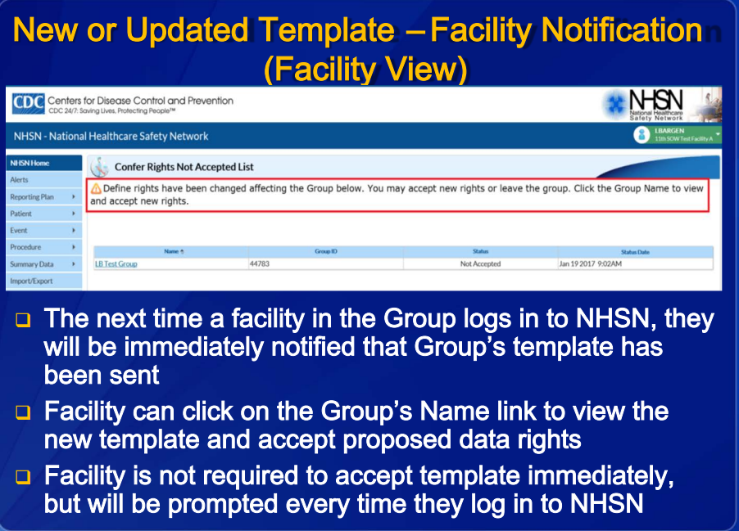

Slide 11
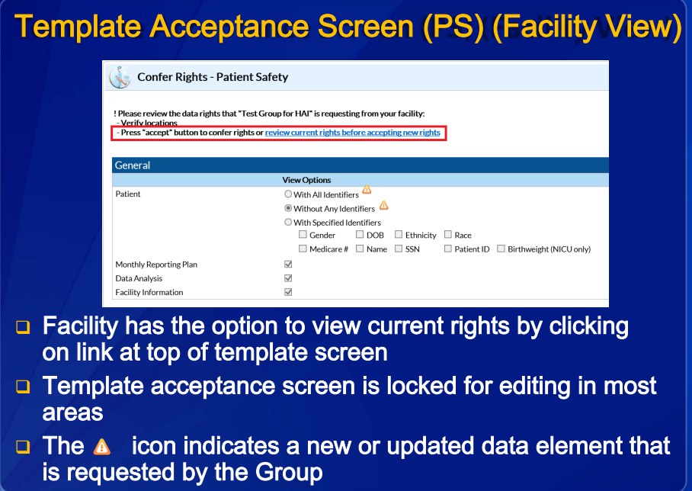

Slide 12
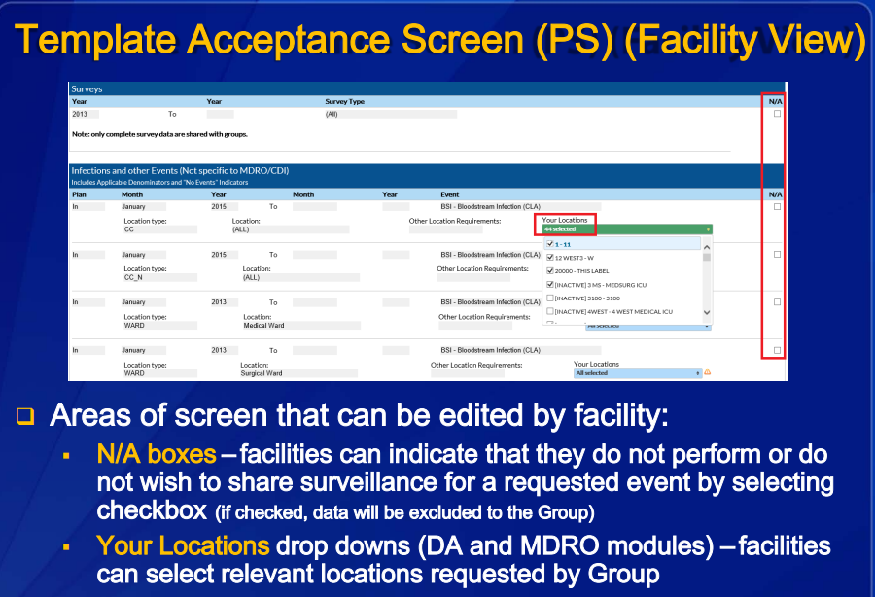

Slide 13
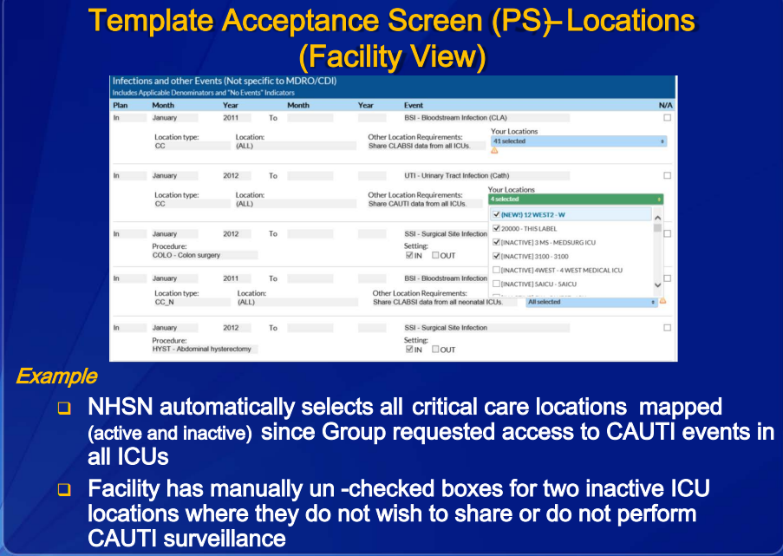

Slide 14
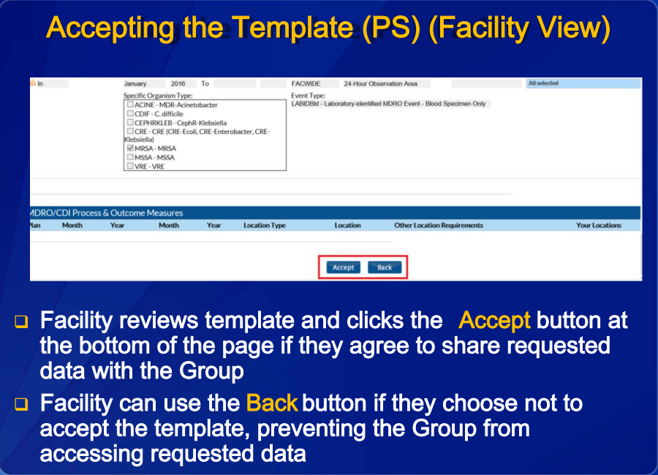

Slide 15
Healthcare Associated Infection Measures
Summary of Measures and Specifications
Measure | Definition | Reporting | Specifications
HAI-6 | Catheter-associated urinary tract infection (CAUTI) rates for adult and pediatric patients in intensive care units, medical units, surgical units, medical/surgical units, mixed acuity units and rehabilitation units | Data must be submitted through NHSN | National Healthcare Safety Network (NHSN) Patient Safety Component Manual Chapter 7
HAI-7 | Surgical Site Infection data for patients undergoing inpatient knee prosthesis (arthroplasty of the knee) surgical procedures (KPRO) | Data must be submitted through NHSN | National Healthcare Safety Network (NHSN) Patient Safety Component Manual Chapter 9
HAI-8 | Surgical Site Infection data for patients undergoing inpatient hip prosthesis (arthroplasty of the hip) surgical procedures (HPRO) | Data must be submitted through NHSN | National Healthcare Safety Network (NHSN) Patient Safety Component Manual Chapter 9

Slide 16
Maine’s Infection Prevention Forum website
Maine’s Infection Prevention Forum Website
Content on website includes the latest infection prevention courses and resources for health care and direct care professionals.
Developed and supported by the Maine CDC, the Maine Quality Forum and the University of Southern Maine
The top three reasons why people register for the core training:
Continued education
Increase knowledge
Requirement
Close to 800 health care professionals have registered for our core infection preventionist online training program representing over 155 facilities.
https://maineinfectionpreventionforum.org/

Slide 17

Support Resource
  NHSN Instructions to Join Group and Confer Rights
    Instructions for joining a group and agreeing to confer rights:
    NHSN document titled, “Data Sharing in NHSN: The Confer Rights Template (Patient Safety Component)”: https://www.cdc.gov/nhsn/pdfs/groups-startup/templatesetup_ps-current.pdf
  Compliance Issues and General Questions
  Kimberly Bonsant, Compliance Officer, Maine Health Data Organization
  Email: Kimberly.Bonsant@maine.gov
  Phone (207) 287-2296

