Slide 1
MHDO Chapter 300: New Reporting Requirements
Financial and Organization Data
Thursday, April 14, 2022 | 2:00 pm

Slide 2
Agenda
Welcome and Introductions
Overview of Chapter 300
Collection of Financial Data
Validation of Organization Data
Timing and Next Steps
Questions

Slide 3
Purpose of the Maine Health Data Organization (MHDO)
MHDO was created by the Legislature in 1995 as an independent executive state agency that operates under the supervision of a multi-stakeholder Board of Directors, which includes representation from: Payers, Hospitals, Providers, Home Health Care, Consumers, Employers and Government.
MHDO’s purpose defined in statute is to create and maintain a useful, objective, reliable and comprehensive health information data warehouse that is used to improve the health of Maine citizens and to promote transparency of the cost and quality of healthcare in the State of Maine.

Slide 4
Maine Health Data Organization
MHDO is responsible for the collection/validation, storage, management, public reporting and release of healthcare data, including claims data, hospital inpatient and outpatient encounter data, hospital quality data, and hospital financial and organizational data (governed by Rule Chapter 300, Uniform Reporting System for Hospital Financial Data).
MHDO’s public reporting of the hospital financial data can be found here: https://mhdo.maine.gov/hospital_financials.htm
MHDO is developing a Provider Directory that will support the management of healthcare provider information in a directory structure. It will contain person-provider identity information and information about relationships to facility providers and health systems. It will list healthcare providers by provider type, specialties, credentials, demographics and service locations. Nesting of service locations within provider groups and health systems will also be identified. The Provider Database will contain the raw data for person providers and facility providers, and extracts can be pulled in a directory format.

Slide 5
Overview of 90-590 Chapter 300, Uniform Reporting System for Hospital Financial Data
Copy of Rule can be found here: https://mhdo.maine.gov/rules.htm
On an annual basis, no later than six months after its most recent fiscal year end: Every parent entity must submit financial data for its Maine hospital(s), subsidiaries, and/or affiliated health care facilities; and
By April 30th of each year (except for the first year): Every health system, parent entity, and hospital must review, edit, and verify its organizational information.

Slide 6
Submission of Hospital Financial Data to MHDO
No changes in how Unconsolidated financial data is reported to MHDO
MHDO Hospital Data Portal
Financial Statements and Template
New: Reporting of Consolidated financial data (in addition to unconsolidated reporting), starting with the four Health Systems in Maine

Slide 7
Requirement in Chapter 300 Regarding the Validation of Organizational Data
The MHDO will pre-populate the baseline organizational information in MHDO’s Hospital Data portal with existing data by 1/31/2020 (delayed due to pandemic).
The health systems and hospitals will review and update the organizational information in the MHDO’s hospital Data Portal by April 30 of each year (first year due date is June 30, 2022)

Slide 8
Data Elements to Validate
Health Systems, Parents, and Hospitals
Organization Names
Names of Affiliated or Unaffiliated Practices
NPI(s)
Primary Taxonomy for each NPI
Address
Phone Number
Fax Number
Website
On CompareMaine
Physicians Employed or Affiliated with Each Hospital and Affiliated and/or Unaffiliated Practice
Name: First, Last, Middle Name or Initial, Prefix, Suffix
Credentials
NPI
Primary Taxonomy
Start Date with Hospital and/or Practice
End Date with Hospital and/or Practice

Slide 9
Accessing the Portal & Browser Requirements
MHDO Hospital Data Portal URL: https://mhdo.maine.gov/hospital_portal/
Minimum Required Browser Settings
Screen Resolution: Optimized for 800x600 or higher
JavaScript: Required
Cookies: Required
Security: SSL/Certificate required for access to restricted resources
Internet Explorer Compatibility View: Turn Off
Notes:
Many of you are existing users of the MHDO Hospital Data Portal, and these browser requirements for accessing the Portal are the standard requirements.

Slide 10
Entity Types and Responsibilities
 | Health System | Parent | Hospital
Review, edit, and validate their baseline organizational information
Review the list of affiliated sub-systems
Review the list of affiliated hospitals and practices
Review, edit, and validate the list of affiliated practices and their baseline organizational information
Review, edit, and validate the baseline organizational information for practices that are unaffiliated with hospitals
Review, edit, and validate the list of physicians that are employed or affiliated with practices that are unaffiliated with hospitals
Add and delete an entity
Add and delete physicians that are employed or affiliated with hospitals and affiliated practices
Notes:
The features and functionality for Organization Data in the MHDO Hospital Data Portal are consistent, no matter if you’re a health system, parent, or hospital user.
Health systems and parent entities can review, edit, and validate everything that is affiliated with the system, and must confirm the relationships among sub-systems and hospitals. Health systems and parent entities are also responsible for reviewing, editing, and validating the organizational information for practices that are unaffiliated with hospitals, including the physicians that are employed or affiliated with those entities.
It’s important to note that practices affiliated or unaffiliated with a health system or hospital need to be individually reviewed, edited, verified, or removed.
Hospitals are responsible for validating their baseline organizational information, along with that of affiliated practices and physicians that are employed or affiliated with hospitals or affiliated practices.

Slide 11
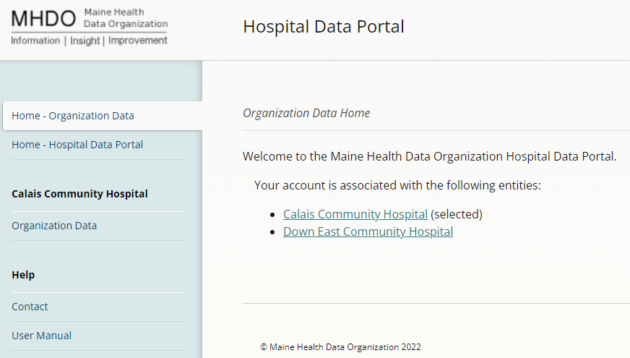
Users Associated with Multiple Organizations
Notes:
This is the Organization Data Home Page. A single user can be associated with more than one organization in the MHDO Hospital Data Portal. If your user account is associated with more than one organization, all organizations will be displayed, and you can switch the organization you are viewing by clicking the organization’s name from this home page. In this example, Calais Community Hospital is selected and if a user wanted to toggle to view the information associated with Down East Community Hospital, they would simply click that link. If a user wanted to return to the home page for the Hospital Data Portal, they would simply click the MHDO logo in the upper left corner of the screen or the “Home – Hospital Data Portal” link in the left navigation.
If your user account is currently associated with a single organization but needs to be associated with one or more other organizations, please contact the MHDO Help Desk.

Slide 12
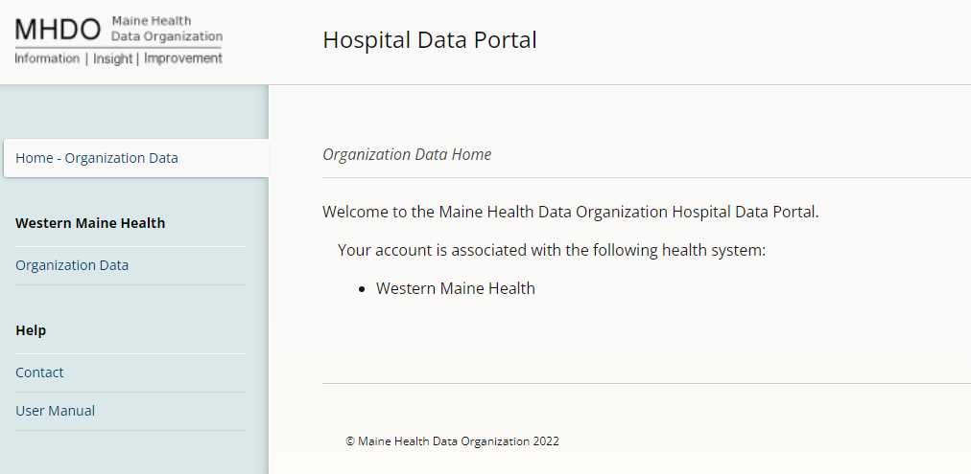
Organization Data Home
Notes:
This is the screen a user will see if they are associated with one entity or a single health system or parent entity. Upon logging into the Portal, a user will see the Welcome screen, with the “Organization Data” in the left navigation. Clicking “Organization Data” will bring users to the main page that outlines the relationships of health systems with sub-systems, parent entities, hospitals, and/or practices.

Slide 13
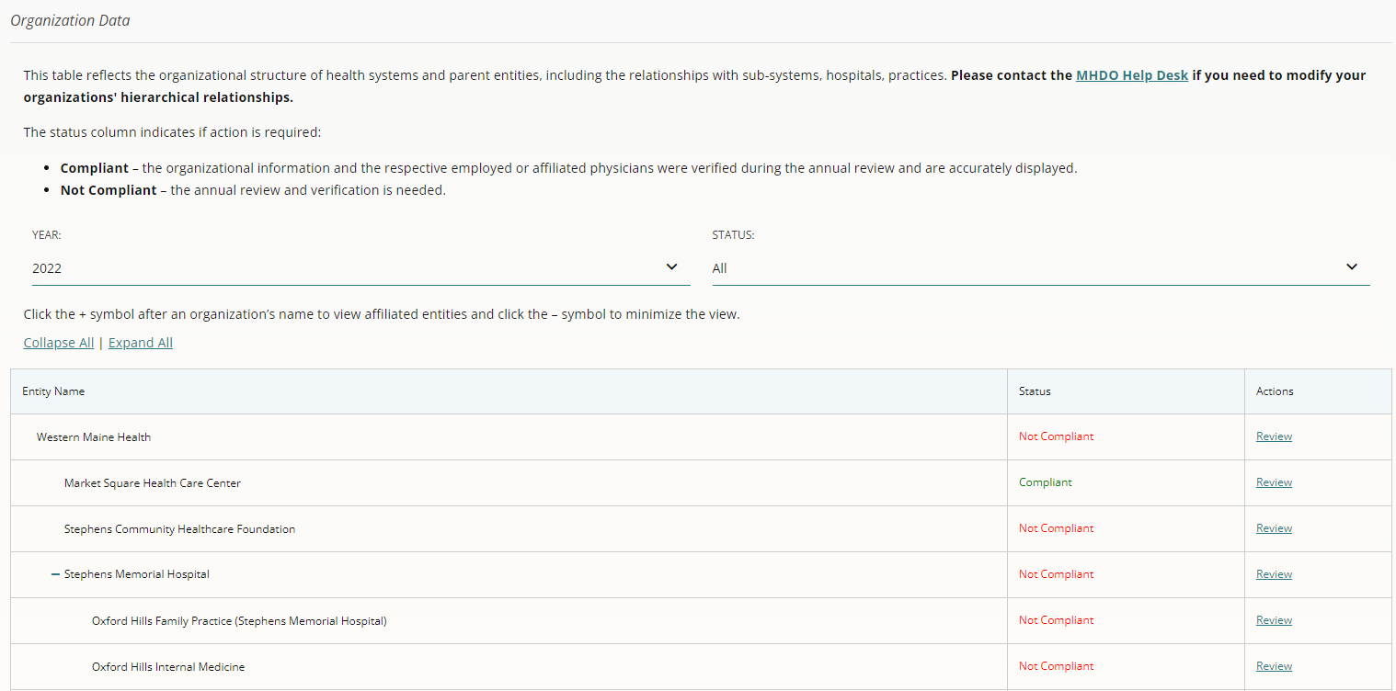
Notes:
This is the screen that outlines the relationships among entities. To distinguish the relationships among them, the list of entities is indented and a +/- sign appears next to an entity’s name to expand or collapse any affiliated entities. Click the +/- signs next to an entity’s name to show or hide affiliated practices. If a +/- sign doesn’t appear next to an entity’s name, there are no affiliated practices. By default, the structure is expanded to show all relationships, statuses, and the current year.

Slide 14
Show or Hide Affiliated Practices
If a +/- sign doesn’t appear next to an entity’s name, there are no affiliated practices.
Notes:
There are also links to “Collapse All” and “Expand All” at the top of the page.

Slide 15
Viewing Statuses
Notes:
Users may use the drop downs to sort by “Year” and “Status” to view the entities that have validated their information (Compliant) in a select year, and which need review and verification (Not Compliant). If entities are incorrectly associated with one another, please contact the MHDO Help Desk, mhdohelp@hsri.org, so the relationship can be correctly assigned.

Slide 16
Review and Verification
Notes:
To begin review and verification, click on “Review” in the “Actions” column. This will bring a user to an entity’s summary page.

Slide 17
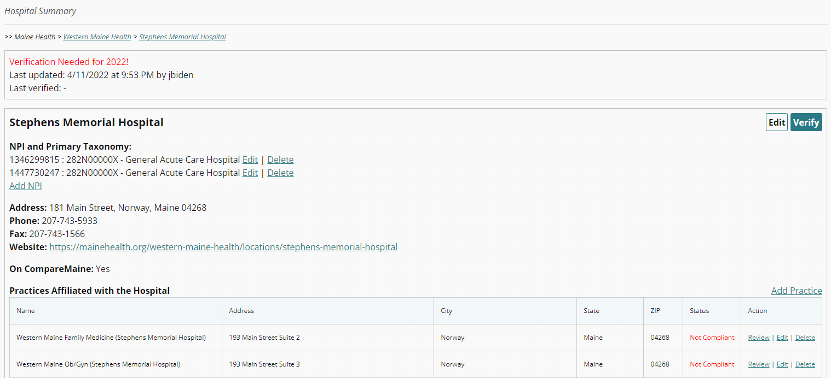
Notes:
Here, you will see breadcrumbs (a text path indicating your location in the portal) at the top of the summary page. These also act as a visual confirmation of the entity that is being reviewed and its affiliated relationships.
The block of information at the top of the page contains: Notifications indicating if verification is required; as well as the date and time stamp the information was last updated or verified and by whom.
Baseline organizational information is displayed for each entity including:
Entity name
Billing NPI(s)
Primary Taxonomy (for each NPI)
Address
Phone
Fax
Website
On CompareMaine, the State of Maine’s healthcare transparency website
In addition to viewing the information on the summary page, users may scroll down on the summary page to the “Practices Affiliated with the Hospital” section and click “Review” to see all organizational information for a practice such as physicians employed or affiliated with the practice and any other affiliated practices.

Slide 18
Notes:
Health systems and parent entities may have practices that are associated with them but not affiliated with another entity. When this occurs, unaffiliated practices will be displayed on the summary page and users can scroll down to see them.

Slide 19
Editing Organizational Information
Notes:
Clicking “Edit” at the top right of a summary page allows a user to make changes to a health system, parent entity, or hospital’s information.

Slide 20
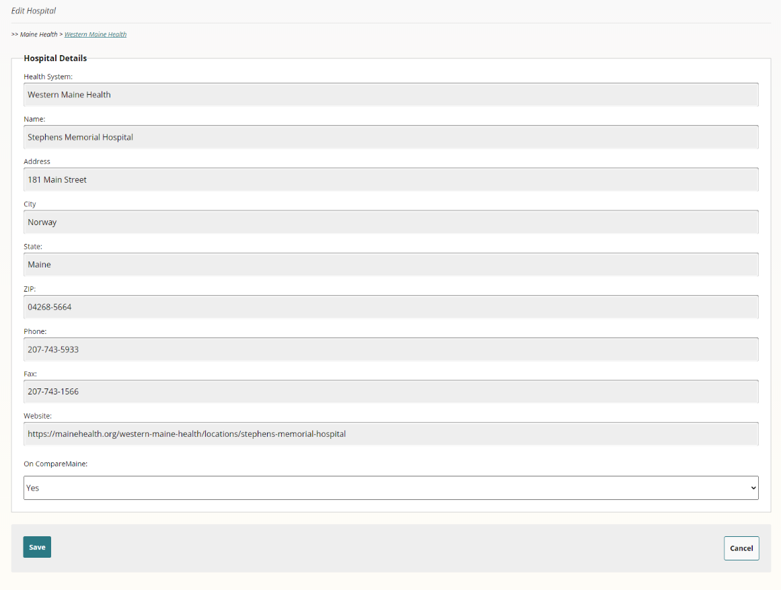
Editing Organizational Information
Notes:
Upon doing so, this form will appear. Except for the billing NPI(s), users can edit most of the entity’s information using the text fields or the drop-down to indicate if the entity is on CompareMaine. Users can “Save” the information or click “Cancel” to return to the previous screen. After clicking “Save” the notification at the top of the page will be updated to reflect the date and time the information was updated and by whom.

Slide 21
Adding, Editing, or Deleting NPI(s)
Notes:
To add a billing NPI associated with the entity, click “Add NPI” on the summary page.

Slide 22
Adding, Editing, or Deleting NPI(s) and Primary Taxonomy
Notes:
Upon doing so, you’ll be prompted to enter the unique 10-digit NPI code into the text field, use the drop-down to select the Primary Taxonomy associated with the NPI, and “Save” the changes to add the NPI or click “Cancel” to return to the summary page. The link “View codes by NUCC” allows users to view a PDF to lookup the primary National Uniform Claim Committee (NUCC) healthcare provider taxonomy code(s) used by the hospital, practice, and employed/affiliated physician. Users are unable to directly edit an NPI. If an NPI is incorrect, users must return to the Summary page, delete the NPI, and add the correct NPI.

Slide 23
Adding, Editing, or Deleting NPI(s)
Notes:
To remove an NPI, click “Delete” next to the NPI. Click “Yes” to confirm removal of the NPI or “No” to return to the summary page.

Slide 24
Adding Practices
Notes:
Returning to the summary page, click “Add Practice” to add a practice affiliated or unaffiliated with a health system, parent entity, or hospital. The same process is used to add unaffiliated practices; however, unaffiliated practices may only be added at the health system or parent level.

Slide 25
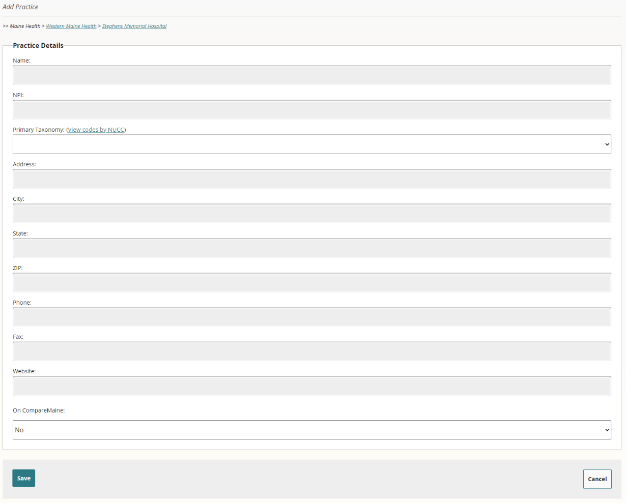
Adding Practices
Notes:
This form, a replica of the one already shown to edit organization information, is used to add practices. Utilize the text fields and drop-downs to complete all required information to add a practice:
Practice Name
Billing NPI
Primary Taxonomy
Address – the ZIP will display five digits on the summary page, regardless of how many subsequent digits are added.
Phone
Fax
Website
On CompareMaine
Once complete, users can “Save” the information to have the practice added to the list of affiliated or unaffiliated practices or click “Cancel” to return to the previous screen.

Slide 26
Deleting Practices
Notes:
Back on the summary page, users can click “Delete” to remove the practice and its association with the entity.

Slide 27
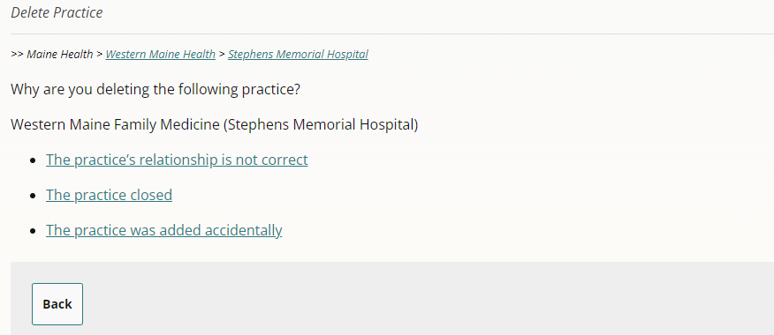
Deleting Practices
Notes:
Doing so will bring users to this screen. Follow the screen prompts to select the reason for removing the practice. If the practice’s relationship is not correct, users are asked to contact the MHDO Help Desk, rather than deleting the practice. This is a critical piece of info, so I’m going to repeat it again – if a practice’s relationship is not correct, users are asked to contact the MHDO Help Desk, rather than deleting the practice. If the practice closed, users must provide the date and reason for the closure. If the practice was accidentally added, users must confirm before removing the practice.

Slide 28
Editing Employed or Affiliated Physicians
Notes:
Going back to the Organization Summary Page, users will see the physicians employed or affiliated with the hospital. Clicking on “Edit” next to a physician’s name allows users to edit:
Rendering NPI
Prefix
First Name
Middle Name
Last Name
Suffix
Credentials
Primary Taxonomy
Start Date with the Entity
End Date with the Entity

Slide 29
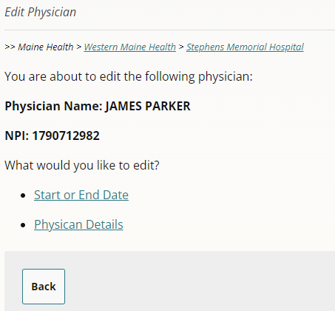
Editing Employed or Affiliated Physicians
Notes:
Upon clicking “Edit” follow the screen prompts to select what you would like to edit: Start or End Date or the Physician Details.

Slide 30
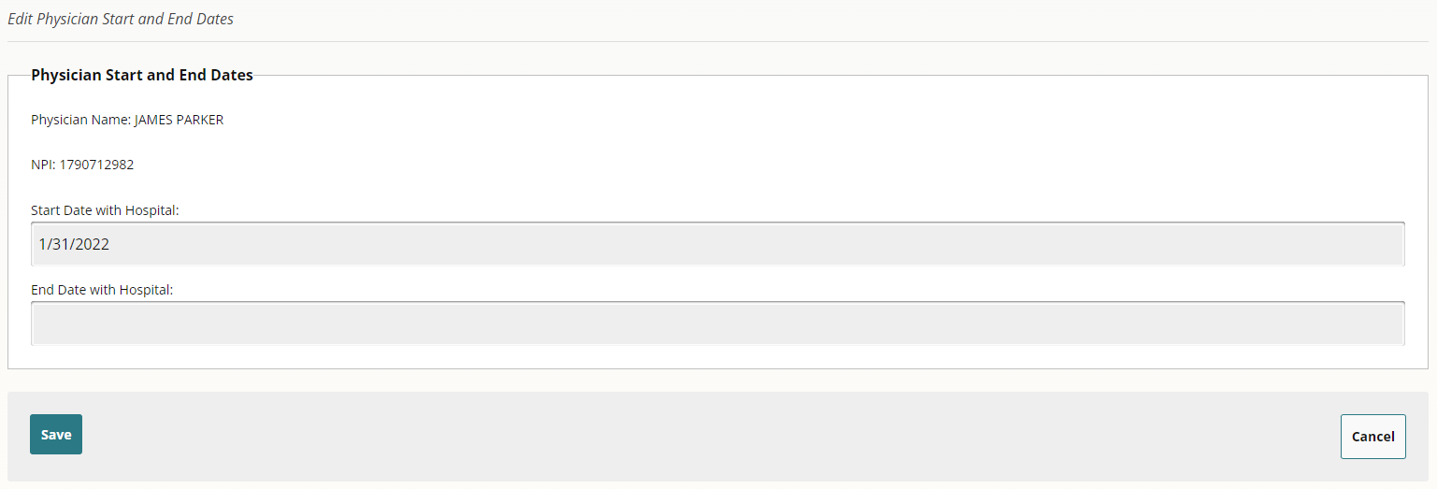
Editing Employed or Affiliated Physicians
Notes:
Editing the “Start or End Date” takes users to this screen. If the physician is employed or affiliated with multiple hospitals or practices, the start and end date is unique to each entity. The format for start and end dates are mm/dd/yyyy.

Slide 31
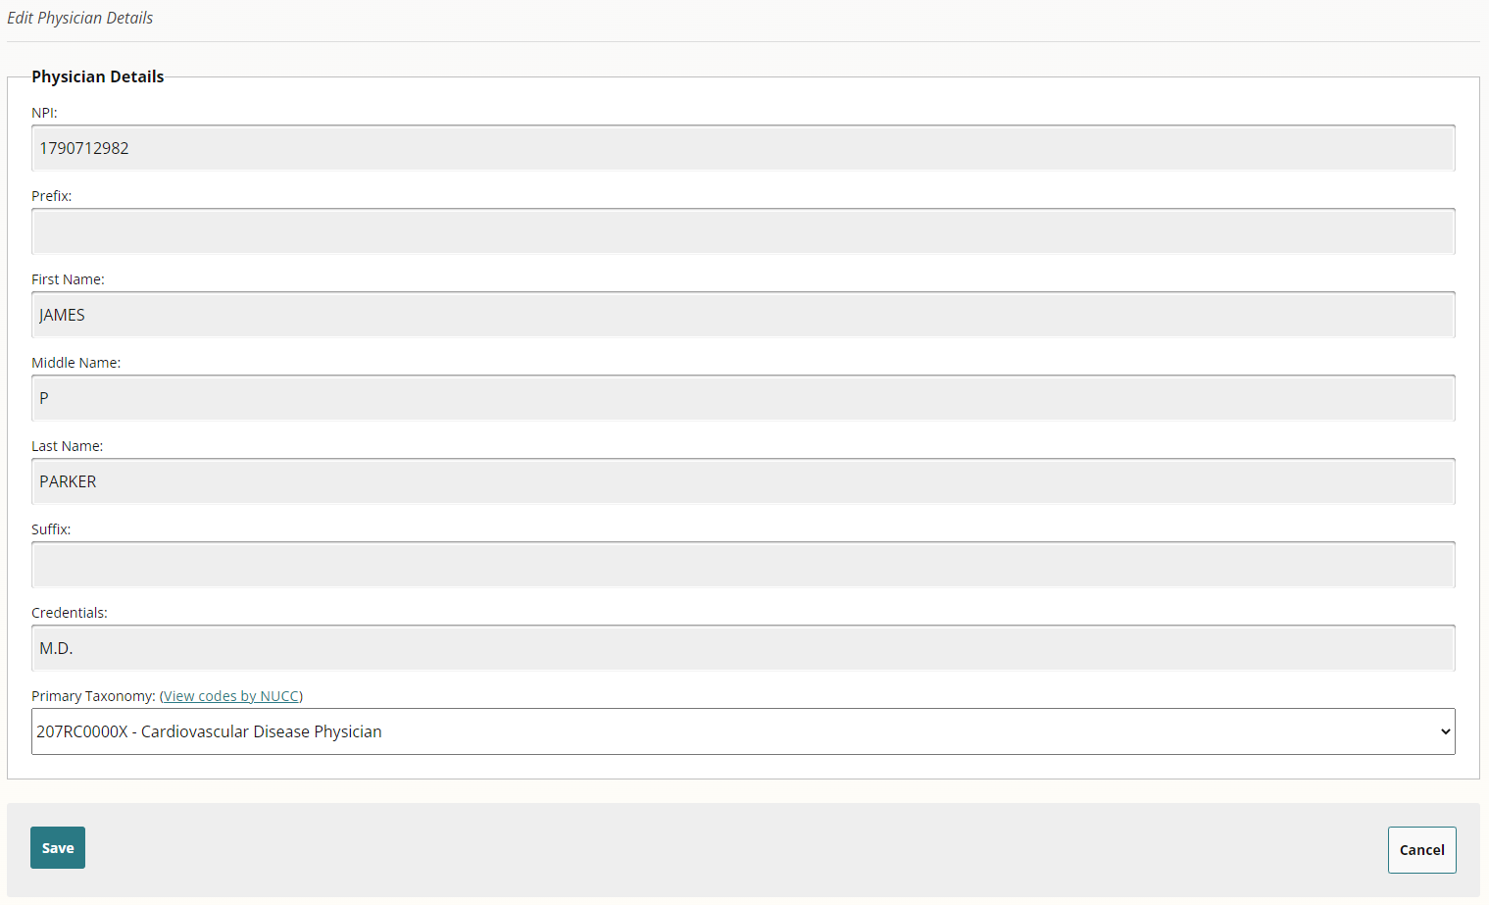
Editing Employed or Affiliated Physicians
Notes:
Since physicians can be employed or affiliated with multiple hospitals or practices, the MHDO Hospital Data Portal has a separate back-end repository that acts as the sole source of information to ensure that the same physician isn’t added multiple times but with different spellings of their name. To this point, when a user edits “Physician Details” the updates won’t be immediately updated; rather, the modifications will be sent to the MHDO Help Desk for review, confirmation, and updating.

Slide 32
Manually Adding Employed or Affiliated Physicians
Notes:
On the Organization Summary Page, a user has a choice of adding physicians one at a time or performing a bulk import when there are several to be added. Clicking “Add Physician” allows users to manually add each physician individually.

Slide 33
Manually Adding Employed or Affiliated Physicians
Notes:
The first step to adding a physician is to enter the unique 10-digit rendering NPI.

Slide 34
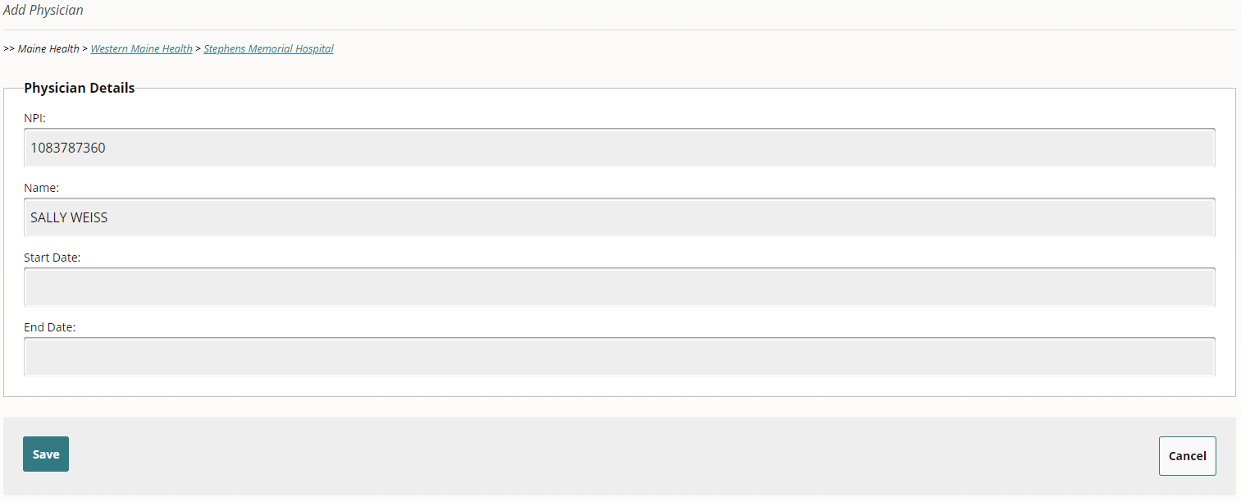
Manually Adding Employed or Affiliated Physicians
Notes:
Upon clicking “Submit” users may see this screen. Since the MHDO Hospital Data Portal has a back-end repository that acts as the sole source of physician information, if a user enters an NPI that already exists, the physician will appear and the start and end dates, unique to that entity, may be added in the format mm/dd/yyyy.

Slide 35
Manually Adding Employed or Affiliated Physicians
Notes:
If a user enters an NPI that doesn’t exist, this screen will appear. Clicking on “Complete these details” allows users to enter the physician’s details, using the same form as previously shown. Clicking “Save” will add the physician to the entity’s list of employed or affiliated physicians and clicking “Cancel” will return the user to the summary page.

Slide 36
Bulk Importing Employed or Affiliated Physicians
Notes:
Rather than manually adding or editing each physician employed or affiliated with a hospital or practice, users have the option to “Bulk Import Physicians” from the summary page to begin an automated process.

Slide 37
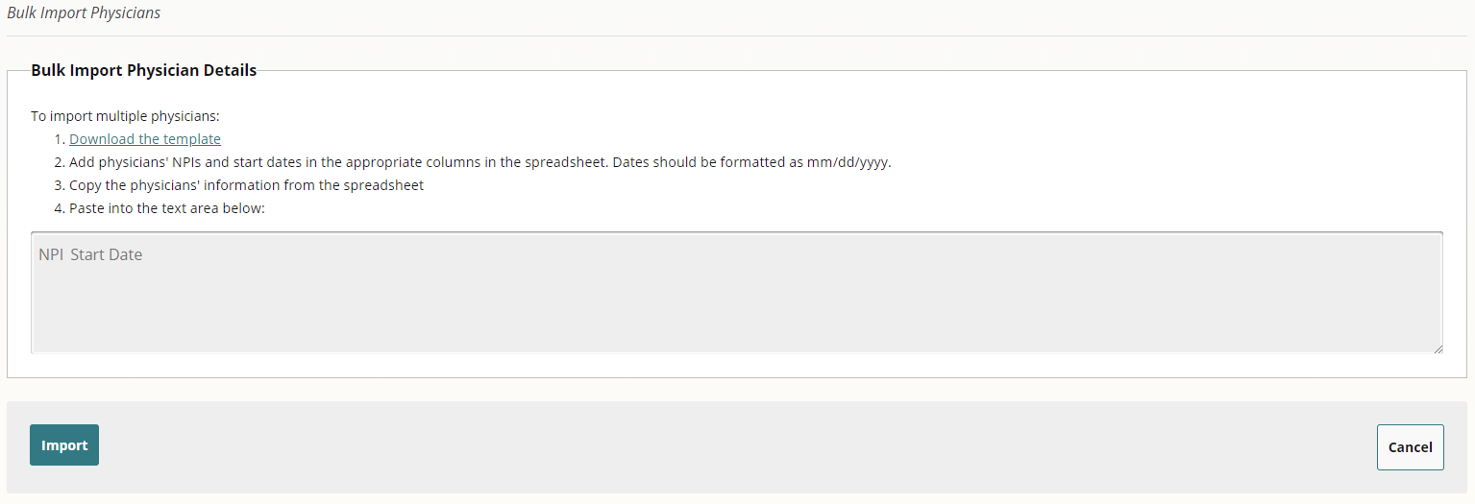
Bulk Importing Employed or Affiliated Physicians
Notes:
To save time and ensure success, it’s important to follow the steps provided on the screen. Begin by selecting the link “Download the template” and open the Microsoft Excel CSV spreadsheet. Using the template, add physicians’ NPIs and start dates in the appropriate columns in the spreadsheet. Format dates as mm/dd/yyyy. Next, copy the physicians’ information from the spreadsheet and paste into the text area on the screen. Then, click Import.

Slide 38
Bulk Importing Employed or Affiliated Physicians
Notes:
Upon clicking “Import,” results are shown that indicate if the physician was successfully found and added in the MHDO Hospital Data Portal database (the separate back-end repository that acts as the sole source of information), or if the physician was not found and needs be added manually. In addition to appearing on the screen, the bulk import results are emailed to the user’s email address for convenience and confirmation.

Slide 39
Bulk Importing Employed or Affiliated Physicians
Notes:
Clicking “Add Manually” opens a new browser window where the physician details may be added, following the same process to manually add physicians. Once the information is added, a user will receive confirmation and be asked to close the browser window to return to the bulk import results. Upon returning to the bulk import results, the newly added physician is shown as being manually added and their details are automatically added to the employed or affiliated physician list.

Slide 40
Verifying the Accuracy of Organization Information
Notes:
Upon reviewing the accuracy of the entity’s information, including employed or affiliated physicians, click “Verify” to confirm the accuracy of the entity’s information.

Slide 41
Verifying the Accuracy of Organization Information
Notes:
Upon clicking that, this on-screen prompt appears confirming that the information displayed is accurate. Once verified, the notification at the top of the page will be updated to reflect the date and time the information was verified and by whom, and the health system, parent entity, hospital, or practice’s status will be changed from “Non Compliant” to “Compliant.”

Slide 42
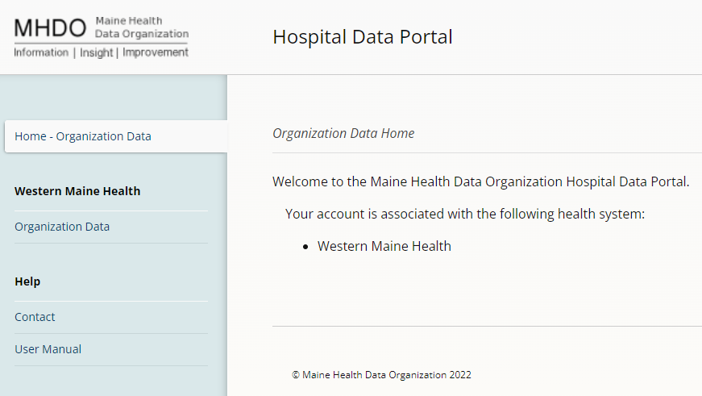
User Manual
A user manual for the Chapter 300 Organization Data is accessible in the hospital data portal.
Notes:
I know we’ve covered a lot of information during our time together and while we’ve tried to make the system as user-intuitive as possible, I understand it can be a bit overwhelming to hear and try and remember it all. For those reasons, we’ve created a User Manual detailing all the steps, along with screenshots, and it’s available directly in the Portal.

Slide 43
Timing and Next Steps
Login to the MHDO Hospital Data Portal: https://mhdo.maine.gov/hospital_portal/
Access the Rule, the recording from today’s webinar, and the Chapter 300 User Manual, as needed: https://mhdo.maine.gov/organizational_data_submitters.htm
Health systems, parent entities, and hospitals shall review, update, and validate their organizational information by Thursday, June 30, 2022.
Notes:
In terms of next steps, please login to the MHDO Hospital Data Portal and confirm that you can see the “Organization Data” in the left side navigation. If you’d like to access the Rule, the recording from today’s webinar, or the Chapter 300 User Manual, you can visit the MHDO website. Lastly, health systems, parent entities, and hospitals shall review, update, and validate their organizational information by Thursday, June 30, 2022. That may seem like a long way away, but we all know how amazing summers in Maine are, so we encourage you to begin the validation process sooner than later. Please contact the MHDO Help Desk with any questions regarding data submissions.

Slide 44
Troubleshooting and Questions
The MHDO Help Desk is available for any technical/system issues you may experience and to assist in the completion of information. Support is available during regular business hours (8 a.m. – 5 p.m. EDT, Monday – Friday). You will receive a call back or an e-mail follow up within two hours of the request.
Toll-free Phone: (866) 451-5876
Email: mhdohelp@hsri.org
Notes:
The MHDO Help Desk is available for troubleshooting and to answer any questions regarding data submissions. Support is available by phone and email during regular business hours, Monday through Friday.

Slide 45
Questions?

Slide 46
Thank You!

