Slide 1

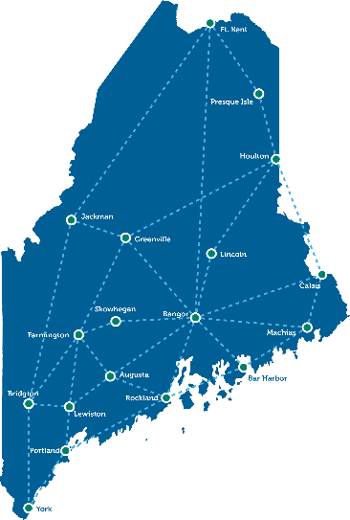
HealthInfoNet Overview: HAI / AR Collaborating Partners Committee
October 26, 2018

Slide 2

Objectives
HealthInfoNet Overview
HIN’s Role for Public Health Reporting
Public Health Quality Measurement
Discussion of Potential Uses for HAI

Slide 3
Mission & Vision
MISSION Statement:
To deliver trusted health information exchange services that help the healthcare community create lasting system-wide improvements in the value of patient care.
VISION Statement:
To be the leading resource of health information exchange series in Northern new England. Partnering with the health care community, HealthInfoNet will deliver innovative technical tools built on comprehensive, timely and actionable information. Services will be responsive to changing clinical decision-making and operational needs across the care continuum.

Slide 4
What is HealthInfoNet?
The Board of Directors are multi-stakeholder group of active and prominent members of the Maine medical community representing Consumers, Providers, Payers, Business and Government.
HealthInfoNet is independent and is not owned by insurance companies, health care organizations, associations, employers or government.
HealthInfoNet is a private nonprofit organization. It is funded by many sources including charitable foundations, Maine health care providers, and state and federal government.

Slide 5
How does it work?
HealthInfoNet’s system combines information from separate health care sites to create a single electronic patient health record.
Patient health information is automatically uploaded from a provider’s electronic health record system.
The information is standardized and aggregated across sites.
HealthInfoNet automates reporting for hospitals public health needs such as syndromic surveillance for Maine CDC & electronic lab reporting for Meaningful Use requirements.

Slide 6
Data Acquisition and QA
HL7 v.2.x data acquired from EHRs and reference laboratories in “near” real-time
  Chief complaint and event of care information is received in seconds
  Coding data (final dx/px) received 12-36 hours
  Laboratory data received from participant and third party reference (ALI, NorDx, Dahl-Chase, & Quest Diagnostics) - All microbiology mapped to standard coding for ELR
Batch Medicaid eligibility and claims (including pharmacy) files received via SFTP monthly
Commercial prescription medication data received from Surescripts/RxHub
All data processed through interface engine and then through a language terminology engine for discrete data elements
  Validation process and user acceptance testing (UAT) conducted with ALL sites at initial onboard and subsequently annual
  Automatic QA for data type, format and site data volume at each site through interface engine and SQL database volume reporting
  Sites address errors identified in sources systems – HIN does not change data received

Slide 7


HealthInfoNet Architecture
HIN State Health Reporting
ELR
Syndromic Surveillance
Immunization Registry
Quality Reporting Dashboard
Medicaid ED Reporting Tool
NNEPTN Reporting Tool
HIE Clinical Portal
HARP Portal
HealthInfoNet
Notification Service (HIN Remedy)
Real
Time
Clinical
Data
Data Mapping
Provider/Org Relationships
Terminology Engine (HIN)
Health Analytics & Reporting Platform (HARP) Population Risk Modeling
Interface
Engine
Messaging
& Documents
Patient Matching EMPI
Public Health Flagging
Clinical Systems: EHRs, Labs, Surescripts, Pharmacy, SDOH
Data Enrichment Services
Micro Batch
&
Batch ETL
Claims
NwHIN Exchange
Gateway
(XDR/XDS)
Clinical
Audit and Authentication
Payer/Attribution
Surescripts Gateway
Clinical Data Repository
(Orion)
HIN Data Warehouse
Raw Data
Store
Social Service
Interfacing services
Medicaid

Slide 8






HIE Connections
Acute Care Hospitals 18
Critical Access Hospitals 16
Mental Health Hospitals 1
Ambulatory 464
Behavioral Health 143
FQHCs 68
Post-Acute Care 46
VA Locations 12
Labs 4
Health Systems 5
Emergency Medical Service 3
Pharmacy 2
Payers 1
Complete list of connections at www.hinfonet.org

Slide 9
HealthInfoNet Business Operations
2018 Annual Expenses: $4.4M
Employees: 18
  (½ technical, ½ program/admin)
Multiple software vendors (“best of breed” operation) including HealthInfoNet
  HealthInfoNet developed three of the five production systems internally as well as the terminology engine (Term Atlas™)
  HBI Solutions, Orion Health, IBM/Initiate, and Systems Engineering are also HIN partners
Revenue sources
  Provider subscription fees for HIE (per patient per year)
    Committed to only charge providers for the operating costs of HIE (not R&D)
    2018 bundled HIE and analytics in core subscription fee
  State (DHHS) Subscription fee model introduced post SIM in late 2017 (per member per year (PMPY)) for Medicaid reporting tools
  MECDC Subscription fee for quality reporting
  Grants/Contracts – Make up the remainder to cover capital research and development as well as programmatic needs

Slide 10

HealthInfoNet HIE Clinical Services
Statewide Clinical Data Repository & Real-time HIE Clinical Portal
  Aggregated and standardized patient level clinical, encounter and diagnostic coding data
  Central resource for accessing patient specific information to support coordination of care and treatment decisions.
Real-Time Notifications Service
  Electronic email “notifications” about specific events of care (i.e., ED & inpatient admin/discharge, new lab results, etc.) Connections to electronic health record systems across the state of Maine

Slide 11

HealthInfoNet Analytics and Reporting
Real time syndromic surveillance, laboratory and immunization registry reporting
Near real-time Predictive Analytics
  Enhance proactive care management to address risk and improve outcomes
  Provide analysis of statewide market share and volume information
Statewide CDC Quality Measure Dashboard allows for real-time assessment of diabetes, hypertension & obesity
Medicaid Utilization Reporting Tool supports Medicaid care management and ED utilization (MaineCare ED Collaborative)
Hospital and Emergency Utilization Dashboard – supports quarterly hospital and emergency utilization reporting to CMS for independent practices participating in the Northern New England Practice Transformation Network

Slide 12








HealthInfoNet Statistics
Over 100,000
Patient Records Accessed per Month
321,211
Patients Managed in Analytics
45,000
Real-time
Notifications per Month
700,000+
Data transmissions sent to Maine CDC in support of Electronic Lab Reporting,
Syndromic Surveillance and Immunization Reporting
(Meaningful Use Measures) per Month
1.6 Million
Unique Lives Managed
14
Predictive Risk Models
(Utilization and Chronic Illness Risk)

Slide 13
Current Public Health Areas of Engagement
Immunization
Mandated Disease Reporting (ELR)
Syndromic Surveillance Reporting (SSR)
Quality Reporting

Slide 14
State Immunization Registry
Reporting of adult immunizations from client sites to the State Immunization Registry
Dose decrement reporting for pediatric vaccine distribution and supply management
Discrete data integration to support analytics
Sites Supported and Working Through User Testing:
  Mid Coast Hospital
  Mid Coast Ambulatory
  EMHS (TAMC, BH, CA Dean, EMMC, Mercy, SVH, Inland)
  Houlton
  Millinocket Regional Medical Center
  Penobscot Valley Hospital
  Mayo Regional Hospital
  Down East Community Hospital
  Cary Medical Center
  Calais Regional Medical Center

Slide 15
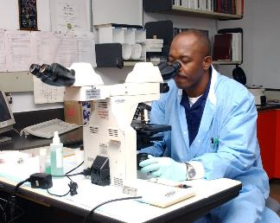
Automated Laboratory Reporting
ELR In Production:
Calais Regional Hospital
Central Maine Health Care (CMMH, Rumford, Bridgton).
Down East Community Hospital
Houlton Regional Hospital
MaineGeneral
Mayo Regional Hospital
Mid Coast Hospital
Pen Bay Medical Center
Penobscot Valley Hospital
Redington-Fairview General Hospital
St Joseph Hospital
Nordx Lab (for MaineHealth affiliated hospitals). Waldo, MMC, LincolnHealth, Western ME
Affiliated Labs (for EMHS affiliated hospitals). EMMC, BH, CA Dean, TAMC, SVH, Mercy, Inland
St Mary’s Regional Medical Center
York Hospital
NorDx All Sites Statewide
Millinocket Regional Medical Center
Cary Medical Center
Maine Coast Memorial Hospital
MDI Hospital
Northern Maine Medical Center
Notify Maine CDC on hospital and reference lab behalf
Specific lab results indicating the existence of one of seventy two diseases mandated for reporting

Slide 16

Syndromic Surveillance
Continuous reporting of events of care where the chief complaint indicates possible disease or condition that requires review/intervention by the Maine CDC

Slide 17
Syndromic Surveillance
SS In Production:
Cary Medical Center
Central Maine Health Care (CMMH, Rumford, Bridgton)
MaineHealth (MMC, Waldo, Lincoln Health, Western ME, Pen Bay)
Mayo Regional Hospital
Penobscot Valley Hospital
St Joseph Hospital
EMHS Hospital and Ambulatory (TAMC, BH, CA Dean, EMMC, Mercy, SVH, Inland)
St Mary’s Regional Medical Center
Reddington-Fairview General Hospital
York Hospital
SMHC
Franklin Memorial

Slide 18
CDC Messages (As of 9/30/18)
Public Health Reporting
CDC Data Services Total: 723,711 ⬆ 80% from September 2017

Slide 19
HIN in Action:
Public Health Reporting
“I am always reminded of the words by former U.S. Surgeon General, Everett Koop, MD:
‘Health care is vital to all of us some of the time, public health is vital to all of us all of the time.’
Data on population health is essential for public health. Accurate reporting of health data is at the core of successful public health programs. Without the data public health will not succeed.”
Stephen Sears, MD, Chief of Staff, VA Maine
and former Maine State Epidemiologist

Slide 20
Maine CDC Statewide Quality
Measures Dashboard
Maine CDC contracted HIN to design the statewide clinical quality measures dashboard to support disease prevention programs.
CDC team requested HIN use NQF “e-measure specifications” when possible.
Together, HIN and the CDC customize the measure specifications to create more informed measures for hypertension and diabetes.

Slide 21
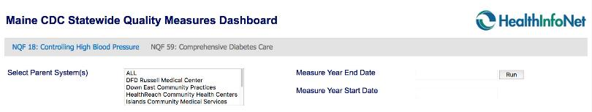
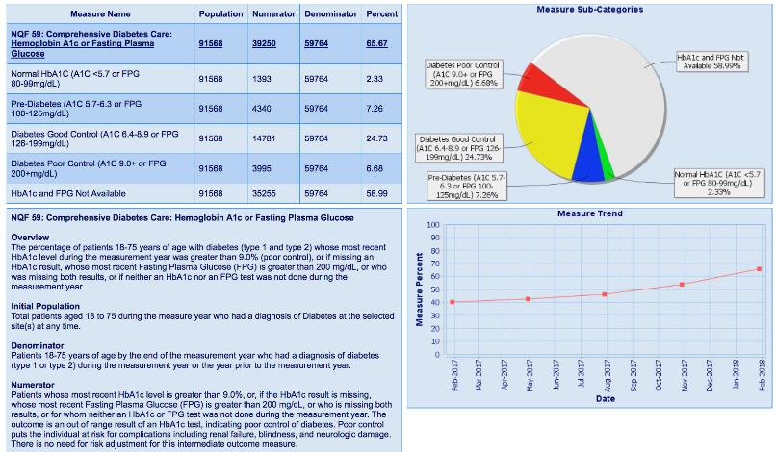
Notes:
End users designed the specific inputs they required for the solution.
Keeping the design simple, intuitive and specific led to great results.
Creating focused data parameters allows a large data set to be actionable. Simple, specified user selections
Data is sort by public health district, county, or town
Choose measure end date as of the previous day.
Map view available and custom data export

Slide 22

Questions and Discussion
Contact Information
Shaun T. Alfreds, Executive Director & CEO
salfreds@hinfonet.org
60 Pineland Drive, Suite 230
New Gloucester, Maine 04260
Main: (207) 541- 9250
www.hinfonet.org

