Slide 1
Chapter 340, Uniform Reporting System for Reporting 340B Drug Program Data Sets
Webinar-January 28, 2025

Slide 2
Maine Health Data Organization (MHDO)
Created by legislature in 1995
Independent executive agency
Multi-stakeholder Board of Directors
Providers
Hospitals
Payers
Consumers
Government

Slide 3
Purpose
To create and maintain a useful, objective, reliable and comprehensive health information data warehouse that is used broadly to improve the health of Maine citizens, and to promote transparency of the cost and quality of healthcare including prescription drug cost information, in the State of Maine

Slide 4
MHDO Hospital Data Sets
Ch. 241: Inpatient and outpatient encounter data
Ch. 300: Financial and Organizational Data
Ch. 270: Quality Data
Ch. 340: NEW. 340B drug program data

Slide 5
Public Law 2023, Chapter 276, An Act to Increase Transparency Regarding Certain Drug Pricing Programs
New law was enacted in 2024
Requires MHDO to collect information in a standardized format from Maine hospitals who participate in the 340B Drug Program and to produce a report that is a summary of the aggregate information received from hospitals and submit the report to the legislative committee on Health Coverage, Insurance and Financial Services and Maine’s Office of Affordable Health Care.
As a result, 90-590 CMR Chapter 340: Uniform Reporting System for Reporting 340B Drug Program Data Sets, was adopted by the MHDO Board of Directors at their September 5, 2024, board meeting and became effective September 17, 2024.
View the New Rule: https://mhdo.maine.gov/rules.htm
View the New 340B Webpage: https://mhdo.maine.gov/340B_hospitals.htm
Notes:
Maybe go to and mention that on our website @ https://mhdo.maine.gov/340B_hospitals.htm are listed the hospitals participating in 340B.
Add that there is a link to most hospital’s website about their 340B. If yours is not included, please let us know and we’ll be happy to include it.

Slide 6
MHDO Hospital Data Portal https://mhdo.maine.gov
Notes:
This is the entry page for the hospital data portal. Some of you may be familiar with this. I’d like to have folks raise their hands if you submit MHDO data via the portal….
For those who are not familiar, you will go to MHDO homepage then select MHDO Hospital Portal.
On the Log in page Hospital Financial Data submitters can use the same username and password to access the Ch 340 portal. You will see a link in the left navigation area for Ch 340 data.If you have forgotten your login information, simply select the “Recover an Existing Account link.”
For all others, you must contact the help desk by March 21st to receive a username and password. PLEASE be sure your hospital determines prior to that date, the individual who will be responsible for data submissions.
Once logged in you will choose the fiscal year you are submitting data for and enter the data requested, which will follow Appendix A of the rule itself. As is with other data sets in the portal, there will be a User Manual, FAQ document and recording of this webinar in the left hand navigation for your assistance.

Slide 7
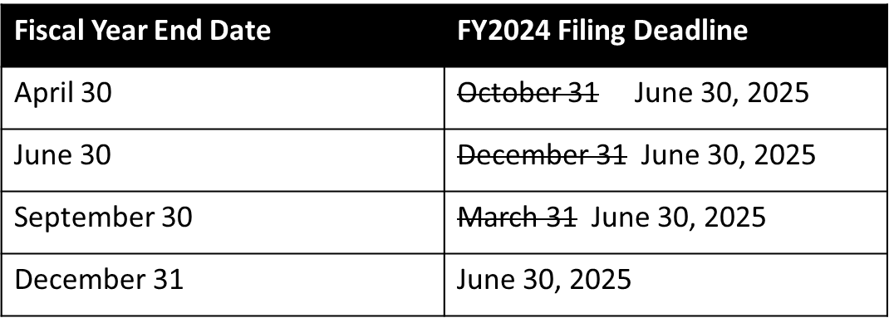
First Annual Submission of Data
The first annual submission of the data required in Ch. 340 will cover the hospital’s FY2024
Notes:
This year, no matter what your fiscal year end data, the deadline is June 30, 2025.
Next year the deadlines will be as designated from the rule, which are the same as your financial data submissions.
Registration information will be necessary, which entails user and hospital information.

Slide 8
Next Steps
Determine Who Will Submit the Data
If the person reporting has a user id and password for the financial data portal, there is no need for action.
Otherwise, contact the help desk by March 21, 2025 to request a user id and password.
April 2025 – 340B Drug Program Data portal will be open for FY24 submissions
MHDO will contact the submitters prior to the date the portal is available and provide instructions.
June 30, 2025 – Data due to MHDO for the first year of reporting based on FY2024
FY2025 Data Submissions
Instructions regarding next year’s annual registration and reporting will be emailed. Registration will include review and updates of facility users, contacts and summary information.
Beginning with FY2025 the submission schedule for this data will follow Section 2.C. of Rule Chapter 340.

Slide 9
Questions
Ch 340 Portal Access
If you do not have a user ID or password, please contact the Help Desk:
Online: https://mhdo.maine.gov/portal/Home/Contact
Email: mhdohelp@hsri.org
Phone: (866) 451-5876
Reporting of Rule Chapter 340 Data:
If you have questions about the requirements of Rule Chapter 340, please contact:
Debra Dodge, Comprehensive Health Planner II, Maine Health Data Organization
Email: Debra.J.Dodge@maine.gov
Phone: (207) 287-6722

