Slide 1
Chapter 300 Financial Data Submission Portal
Participant Reminders:
Please mute your line.
Please submit your questions via webinar Chat feature.
We will address as many questions as possible at the end of today’s webinar. For those questions we are unable to get to answers will be distributed to the group
October 23, 2018

Slide 2
Agenda
Welcome and Introductions
Overview of MHDO Transformation Project
New On-Line Submission Portal
Review Registration and Data Submission Steps
Portal Demonstrations
Questions

Slide 3
Overview of Transition
MHDO is streamlining the submission of Chapter 300 Hospital Financial Data from a workbook submitted via email to an online portal.
The primary benefits of this transition are:
submission of data is more secure;
sorted more efficiently;
availability of historical hospital submissions, including audited financial statements;
quicker turnaround of annual reports;
ability to generate adhoc reports for hospital planning purposes and;
ability to generate reports for long term financial data analysis.

Slide 4
Overview of Transition
Starting with FY 2018 Financial data:
Data will be submitted through MHDO’s hospital portal via an online form.
Submissions will no longer be entered into excel workbooks and instead will be entered and validated through the online portal.
Audited Financial Statements will be uploaded through the portal
Go Live the week of November 19th

Slide 5
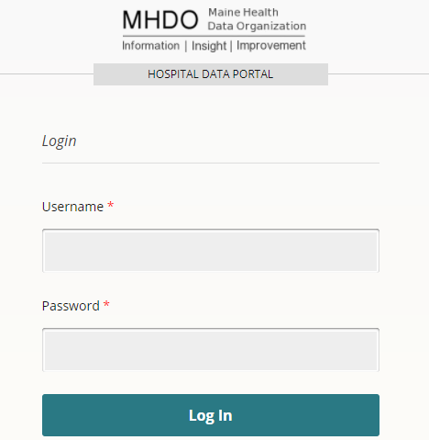
Accessing the New Portal
MHDO Hospital Data Portal URL:
https://mhdo.maine.gov/hospital_portal/

Slide 6
Submitter Registration
Person(s) who submit Chapter 300 data to the MHDO need user accounts.
MHDO and HSRI will pre-register users
Users will receive an email from portal@mhdo.maine.gov with your username and temporary password

Slide 7
Data Submission
Navigate to the Financial Data page link on the left, below your Hospital facility name
Click “Enter New Data”
Select the MHDO ID and Year you’re submitting for and Click “Add”

Slide 8
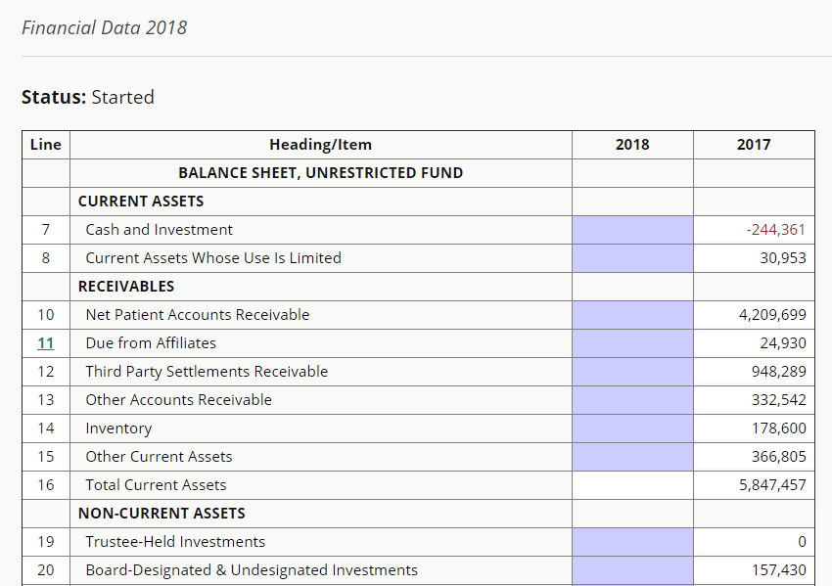
Data Submission
Data from the previous year is automatically loaded
Complete the shaded fields for the selected year - Updates are saved automatically
Worksheets must be completed when an automated message appears. You may also access the worksheets by clicking on the corresponding line # (11, 21, 22, 33, 39, 95, 115, 126, 138).

Slide 9
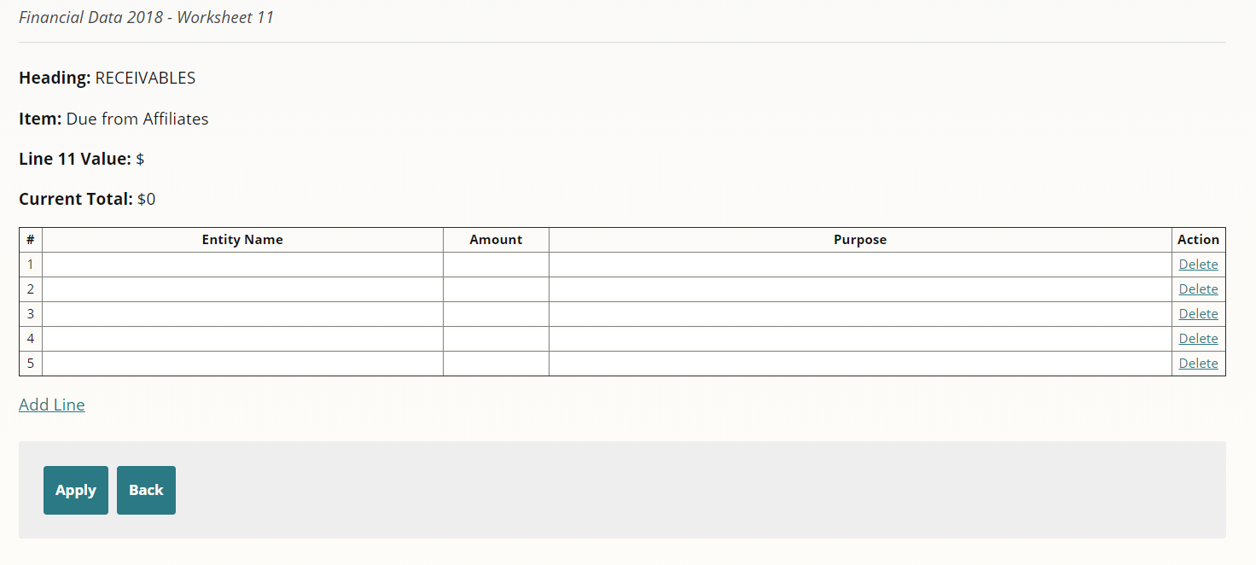
Data Submission
Worksheets:
Complete each row as needed
Click “Apply” to have the worksheet values applied to the appropriate Line on the template
If worksheet issues are detected by the validations, a message will be displayed
If there are no errors on the worksheet, you will be brought back to the template

Slide 10
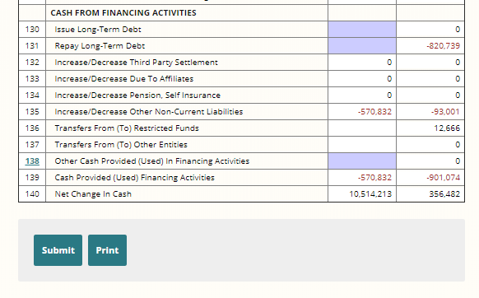
Data Submission
Click the “Submit” button when all required fields are complete and you are ready for MHDO to review your submission
If issues are detected by the validations, a message will be displayed indicating which lines need to be corrected

Slide 11
Audited Financial Statement - File Naming
This step is critical to the proper identification and attribution of financial data. The file name must be constructed using the following convention:
FIN-XXXXXX-yyyy.pdf
FIN identifies the data submitted as financial data required by MHDO Chapter 300.
XXXXXX identify your hospital's MHDO ID number, which can be found on the Financial Data Page on the MHDO website. (A list of hospitals and their MHDO ID’s will be provided)
yyyy specify the four-digit reporting year.
Please note that the dashes ARE necessary and do not add spaces.
Example:
FIN-123456-2018.pdf

Slide 12
Data Submission
To upload the Audited Financial Statement (AFS) for the year click “Upload AFS”

Slide 13
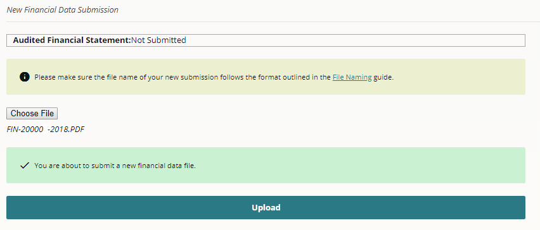
Data Submission
Click “Choose file” and navigate to the file you are going to upload
Click “Upload” to upload the file
You should get success or failure messages indicating whether transmission of the file was successful

Slide 14
Portal Demonstration

Slide 15
Additional Resources
MHDO Website Hospital Financial Data Page
https://mhdo.maine.gov/financial_data_submitters.htm
Today’s webinar has been recorded and will be made available by the end of the month.
Submission information and updates are posted on the website.

Slide 16
Troubleshooting
Technical Support
The MHDO Help Desk is available for any technical/system issue you may encounter. Support is available during regular business hours (8 a.m. – 5 p.m. EST, Monday – Friday).
Email: mhdohelp@hsri.org
Compliance and Completing Forms
Questions relating to completion of the forms, deadlines for submissions, or extension requests can be directed to Debra Dodge debra.j.dodge@maine.gov

Slide 17
Hospital List
A list of hospitals, parent entities, and their MHDO IDs will be provided in the coming weeks.

Slide 18
Q & A

